Slide 1
Micron Bendemeer
Sean Lam
Jan 2024

Slide 2
Micron Bendemeer Jar Tests Summary (1 of 2)
 | A) 03 Oct 23 | B) 03 Oct 23 | C) 09 Oct 23 | D) 09 Oct 23 | E) 22 Dec 23
Remarks | Individual-batch feed blend; Without pH correction | Individual-batch feed blend; Without pH correction | Individual-batch feed blend; With pH correction | Individual-batch feed blend; With pH correction | Individual-batch feed blend; With pH correction
Coagulants [dosages, in mg/L] | Alum [50; 100; 150; 200; 250] | PAC [50; 100; 150; 200; 250] | Alum [50; 100] | PAC [10; 150] | MgCl2 [600; 1,150; 2,250; 4,480]
Total Silica, mg/L Feed Supernatant | 370 149-161 | 375 145-373 | 560 156-571 | 570 149-561 | 361 2.8-11.2
Best Cases | Alum 50, 100 mg/L | PAC 100, 150 mg/L | Alum 50 mg/L (pH5.5) | PAC 150 mg/L (pH6.5) | MgCl2 2,250mg/L (pH10.5)

Slide 3
Micron Bendemeer Jar Tests Summary (2 of 2)
 | F) 02 Jan 24 | G) 04 Jan 24 | H) 10 Jan 24 | I) 17 Jan 24
Remarks | Bulk feed blend; Simultaneous PolyDADMAC & MgCl2 dosing | Bulk feed blend; Sequential PolyDADMAC & MgCl2 dosing | Bulk feed blend; Sequential PolyDADMAC & MgCl2 dosing | Bulk feed blend; MgCl2 / MgO
Coagulants [dosages, in mg/L] | PolyDADMAC [50; 100] MgCl2 [200; 300] | PolyDADMAC [0; 50] MgCl2 [200; 300; 400] | PolyDADMAC [0; 25] MgCl2 [705; 825; 940] | MgCl2 [470; 590; 705] MgO [200; 250; 300]
Total Silica, mg/L Feed Supernatant | 581 159-253 | 540 141-327 | 510 2.7-10.6 | 616 20-270
Best Cases | PolyDM 100mg/L & MgCl2 300mg/L (pH 11.0) | PolyDM 50mg/L & MgCl2 400mg/L (pH 11.0) | MgCl2 940mg/L (pH 11.0) | MgCl2 705mg/L (pH11.0)

Slide 4
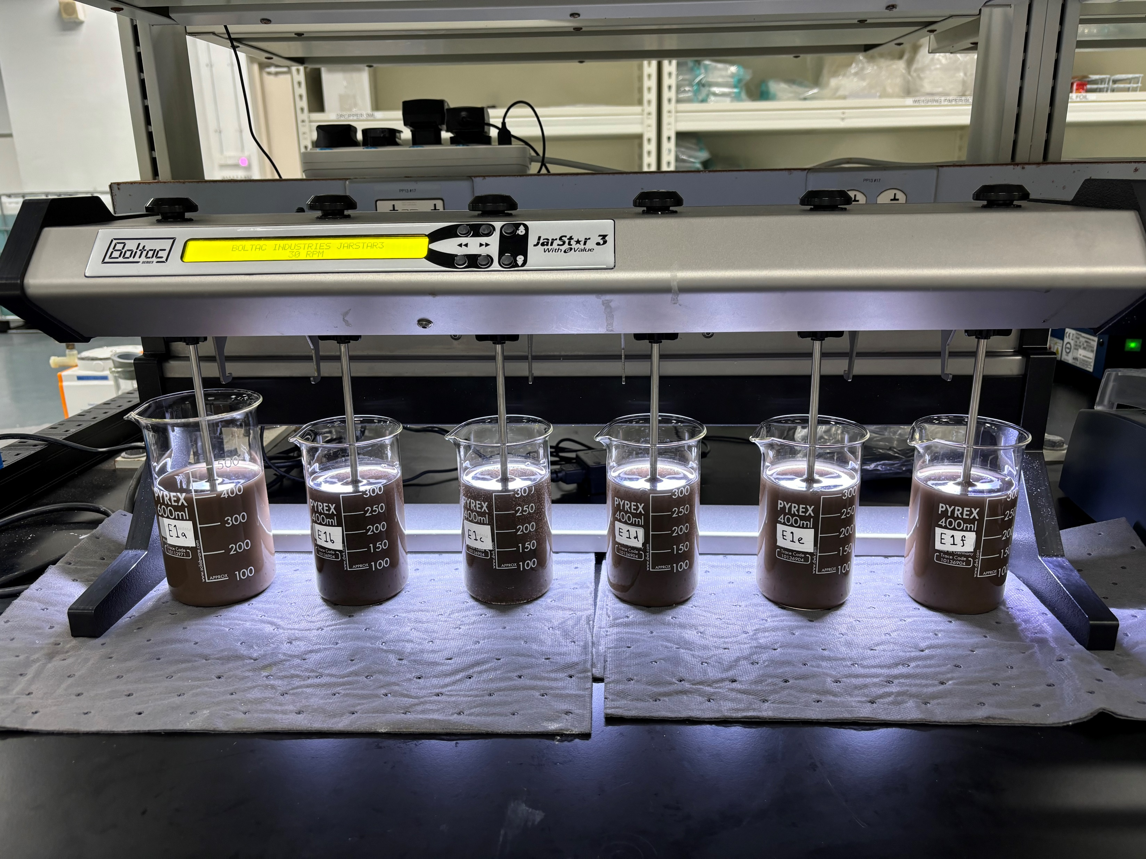
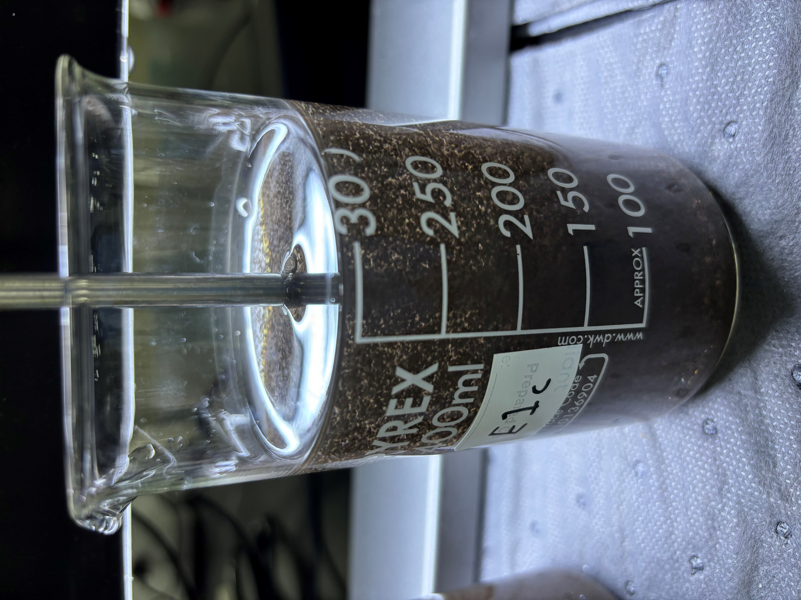
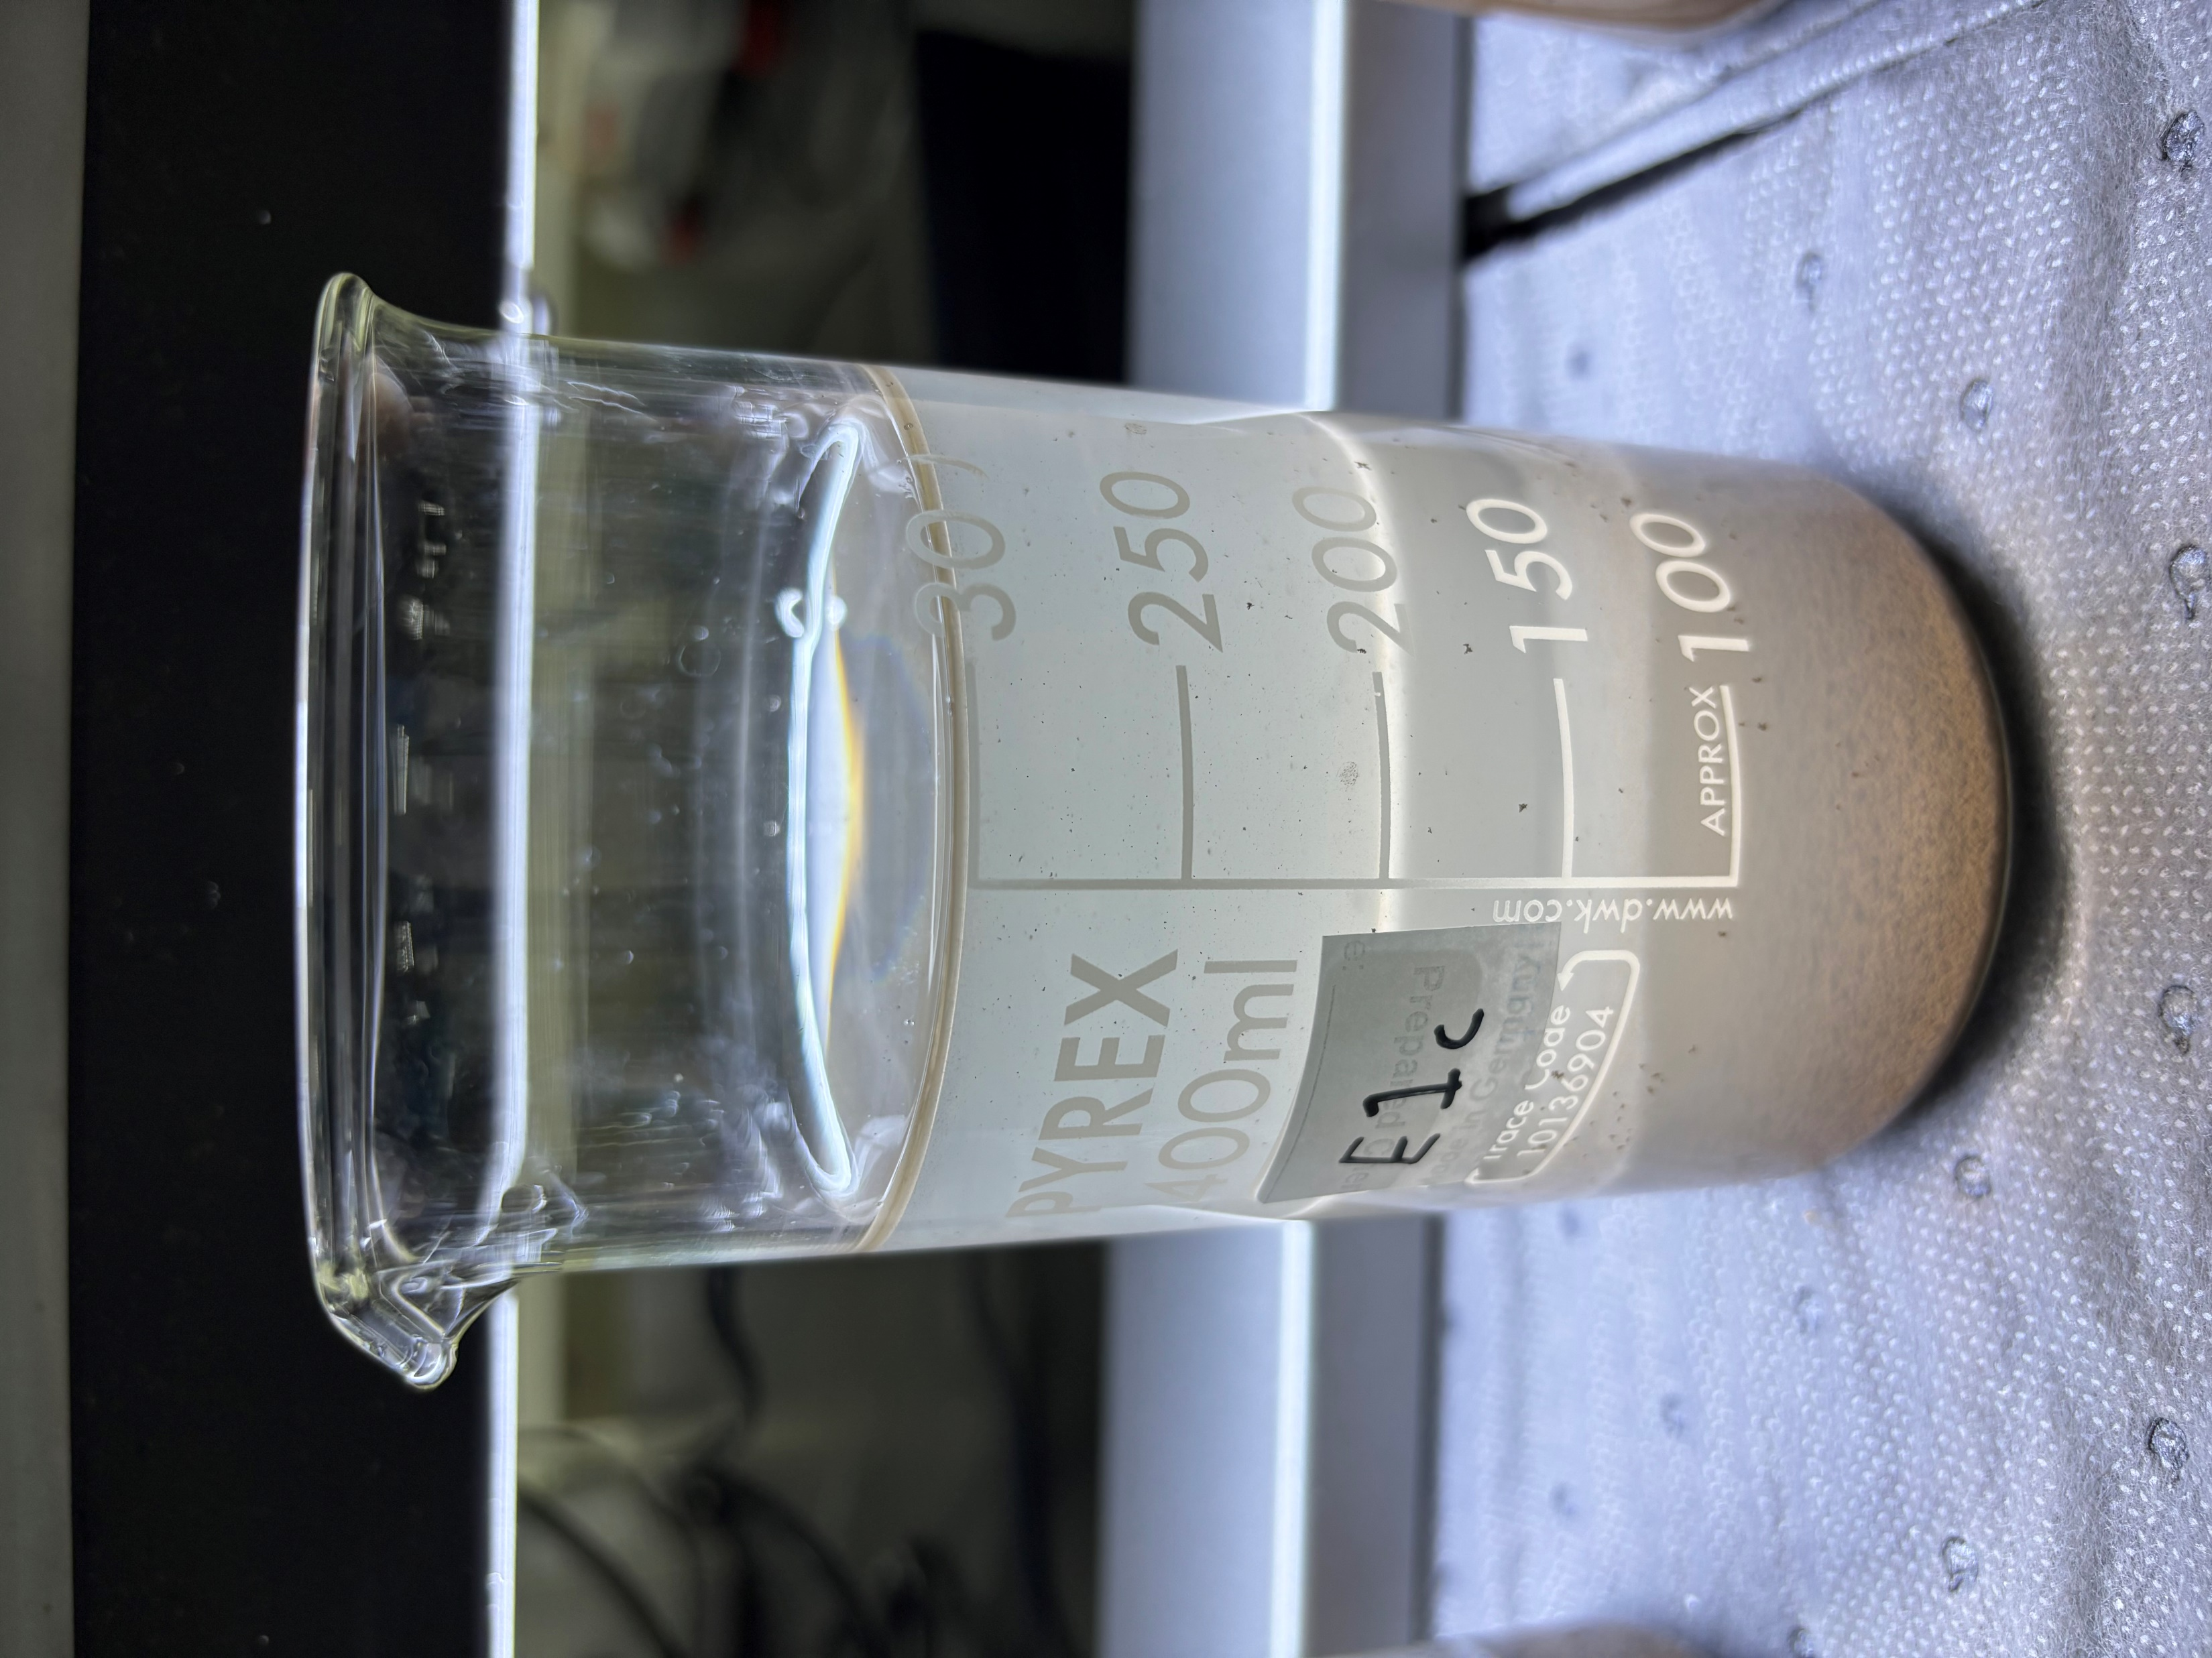
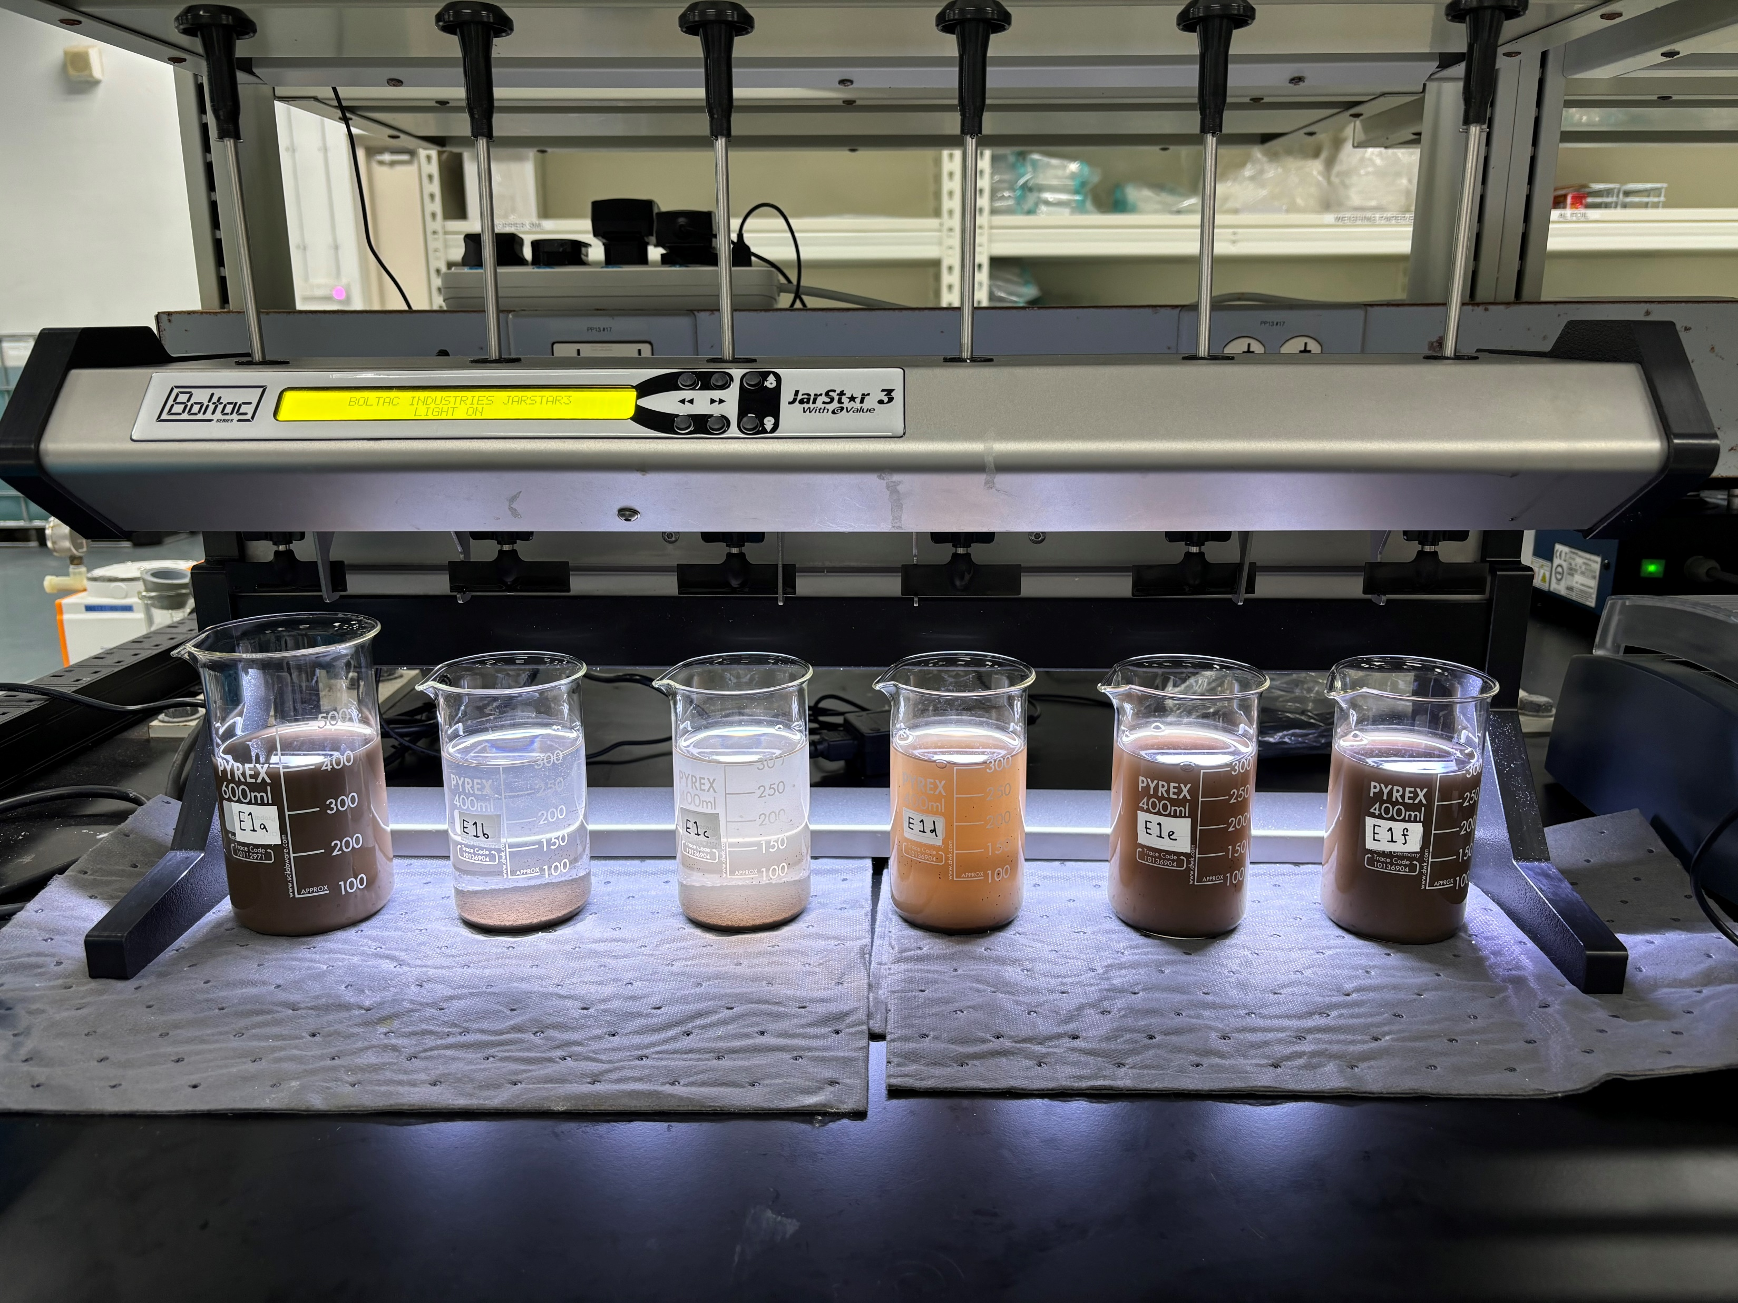
A) 03 Oct 23 Results – Alum w/o pH correction
Initial
Final
Coagulant addition
Polymer addition
Control
Alum (mg/L): 50 100 150 200 250

Slide 5
A) 03 Oct 23 – Alum w/o pH correction
Test E1 – Alum | (a) 0mg/L | (b) 50mg/L |  | (c)100mg/L |  | (d) 150mg/L |  | (e) 200mg/L |  | (f) 250mg/L
 | Feed | Supernatant | *Filtered Supernatant | Supernatant | *Filtered Supernatant | Supernatant | *Filtered Supernatant | Supernatant | *Filtered Supernatant | Supernatant | *Filtered Supernatant
pH | 5.56 | 4.15 | 4.18 | 4.08 | 4.08 | 4.42 | 4.05 | 3.95 | 3.96 | 3.93 | 3.94
Turbidity, NTU | 4,980 | 29.2 | 0.855 | 78.9 | 0.594 | 415 | 2.31 | 842 | 4.61 | 1,353 | 158
TSS, mg/L | 2,430 | 18 | <3 | 33 | <3 | 190 | <3 | 448 | <3 | 926 | 86
Total Silica, mg/L | 370 | 161 | 147 | 149 | 150 | 150 | 152 | 149 | 153 | 154 | 151
Conductivity, μS/cm | 39.6 | 146 | 143 | 209 | 208 | 274 | 274 | 332 | 33 | 387 | 383
*Filtered Supernatant (0.45μm)

Slide 6
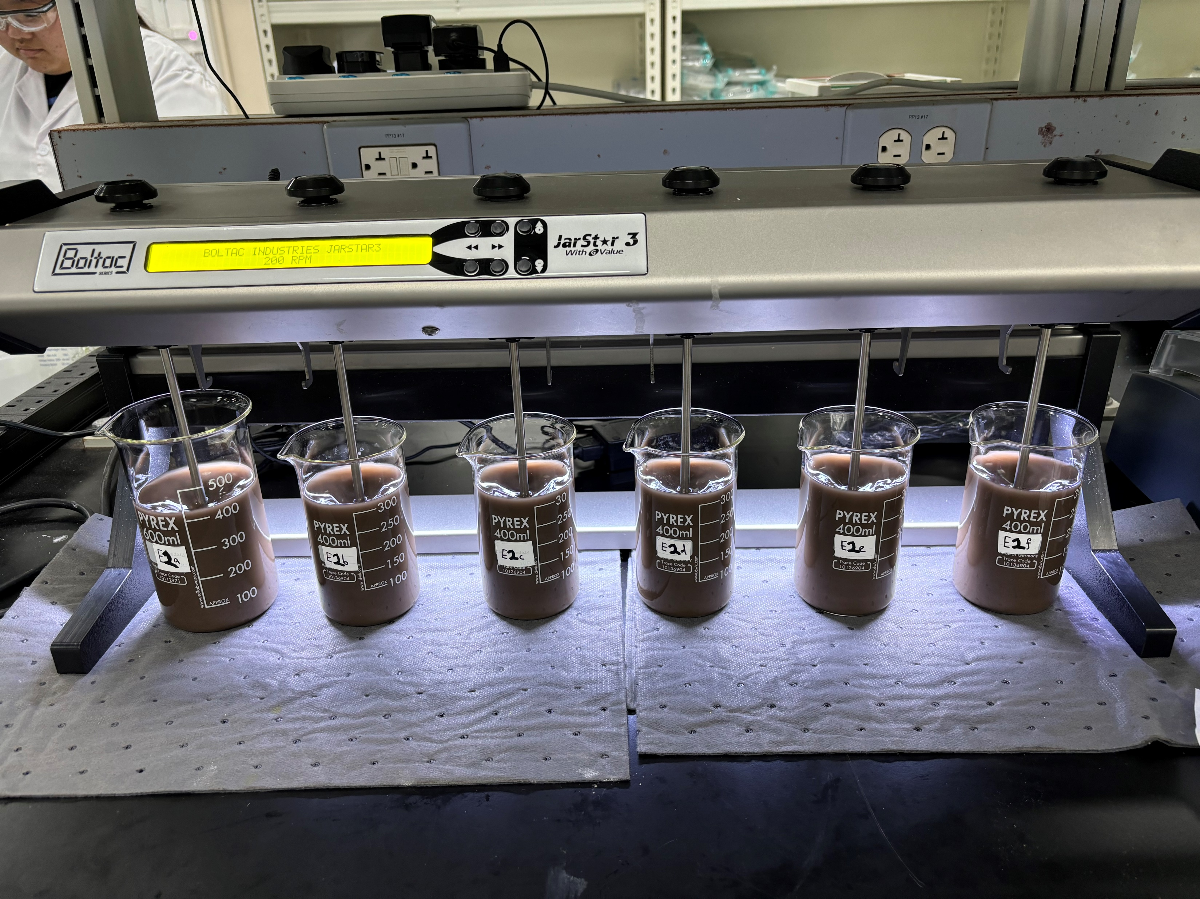
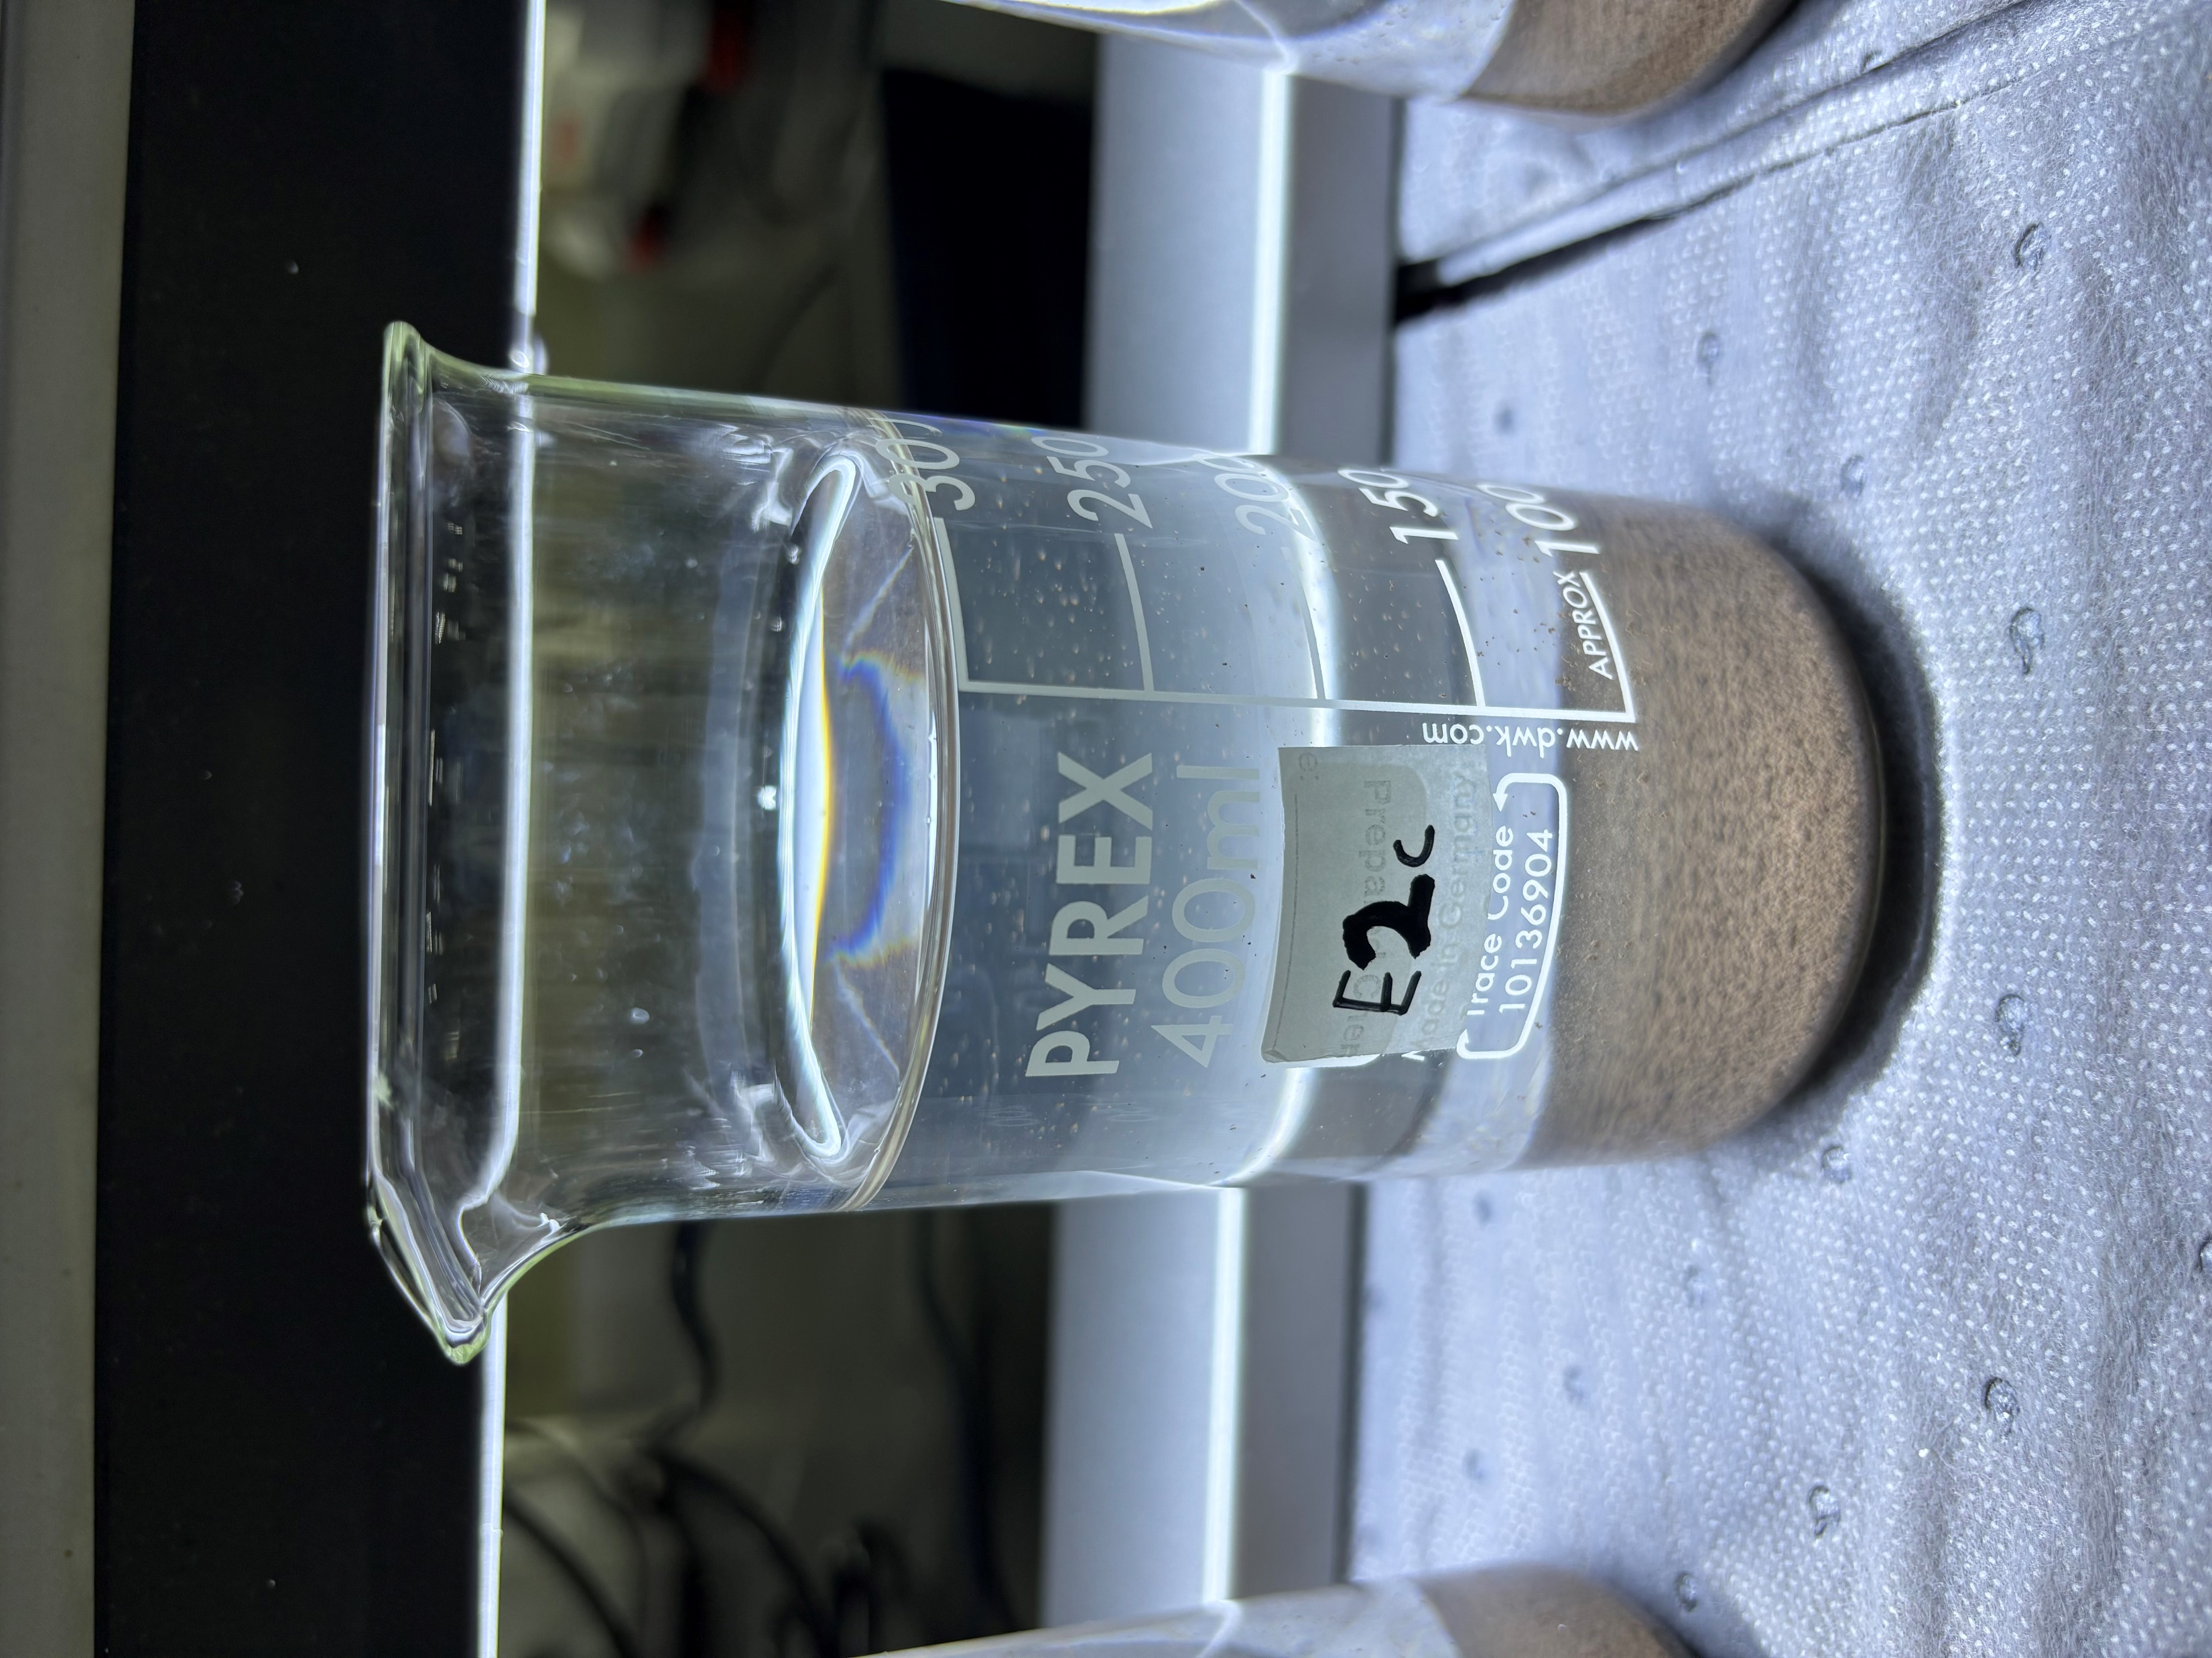
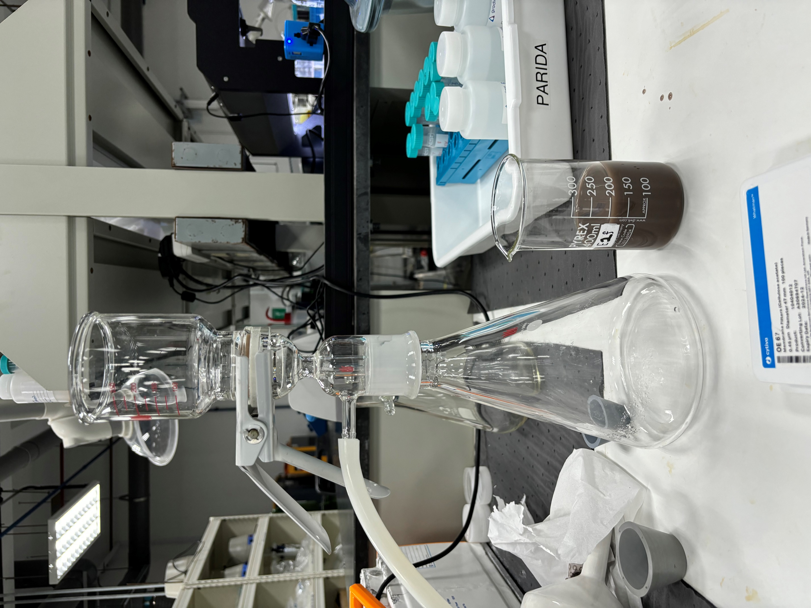
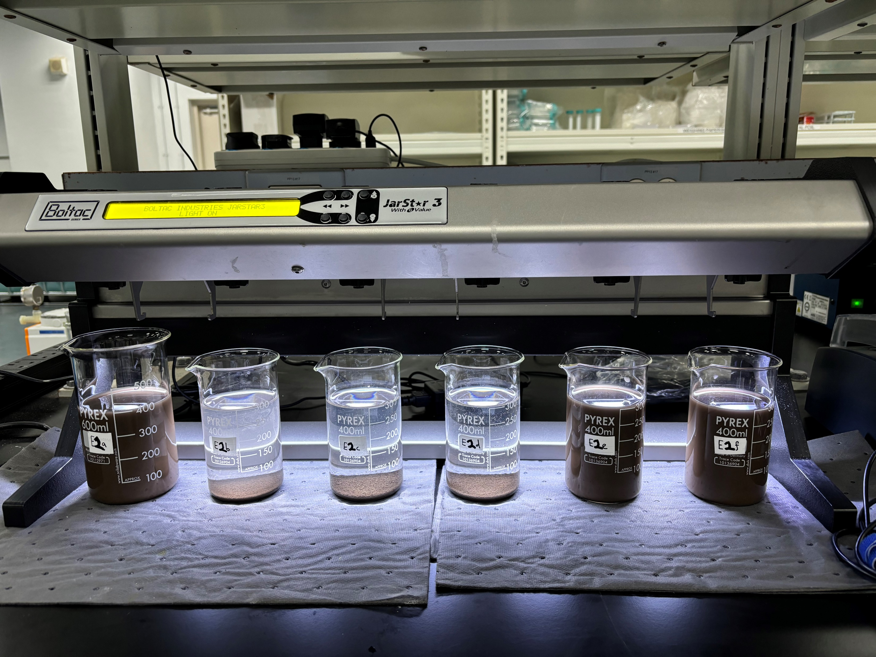
B) 03 Oct 23 Results – PAC w/o pH correction
Initial
Final
*Unable to use syringe filter (0.45μm)
Control
PAC (mg/L): 50 100 150 200* 250*

Slide 7
B) 03 Oct 23 – PAC w/o pH correction
Test E2 – PAC | (a) 0mg/L | (b) 50mg/L |  | (c)100mg/L |  | (d) 150mg/L |  | (e) 200mg/L |  | (f) 250mg/L
 | Feed | Supernatant | *Filtered Supernatant | Supernatant | *Filtered Supernatant | Supernatant | *Filtered Supernatant | Supernatant | *Filtered Supernatant | Supernatant | *Filtered Supernatant
pH | 5.49 | 4.72 | 4.7 | 4.4 | 4.4 | 4.43 | 4.47 | 4.2 | 4.2 | 4.01 | 3.5
Turbidity, NTU | 4,970 | 40.4 | 0.627 | 7.02 | 0.176 | 4.87 | 0.107 | 4,830 | 30.9 | 4,980 | 5.97
TSS, mg/L | 2,470 | 21 | <3 | 3 | <3 | <3 | <3 | 2,370 | 15 | 2,410 | <3
Total Silica, mg/L | 375 | 153 | 149 | 145 | 145 | 149 | 148 | 373 | 173 | 373 | 184
Conductivity, μS/cm | 33.6 | 50.5 | 50.4 | 82.5 | 81.8 | 75 | 75.2 | 189 | 180 | 303 | 563
*Filtered Supernatant (0.45μm)

Slide 8
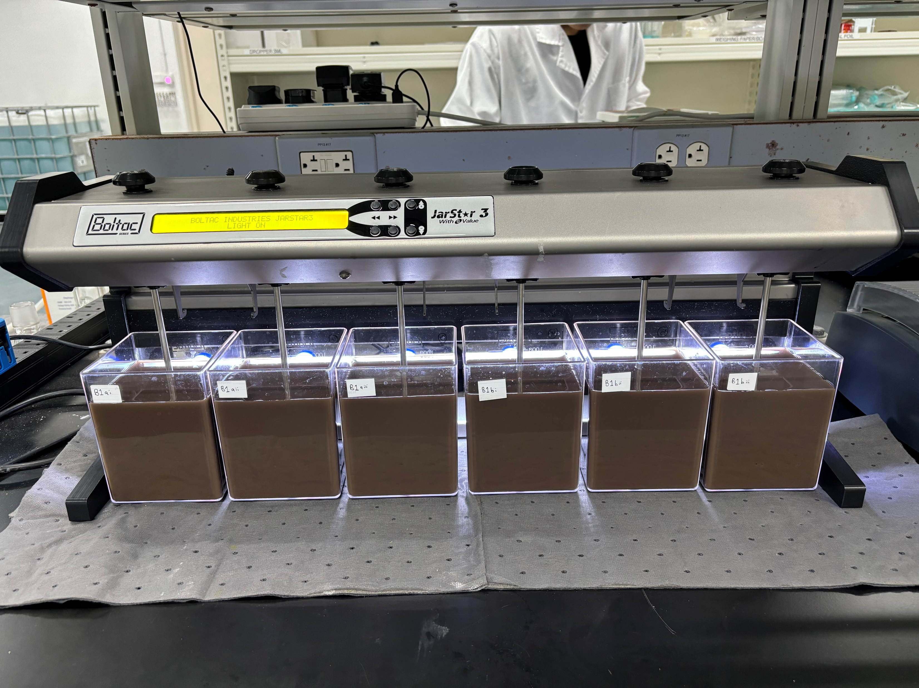
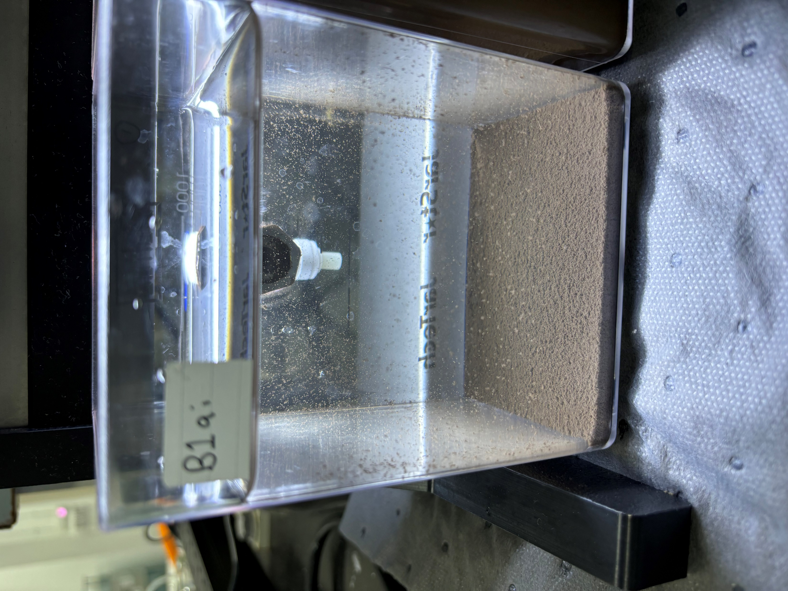
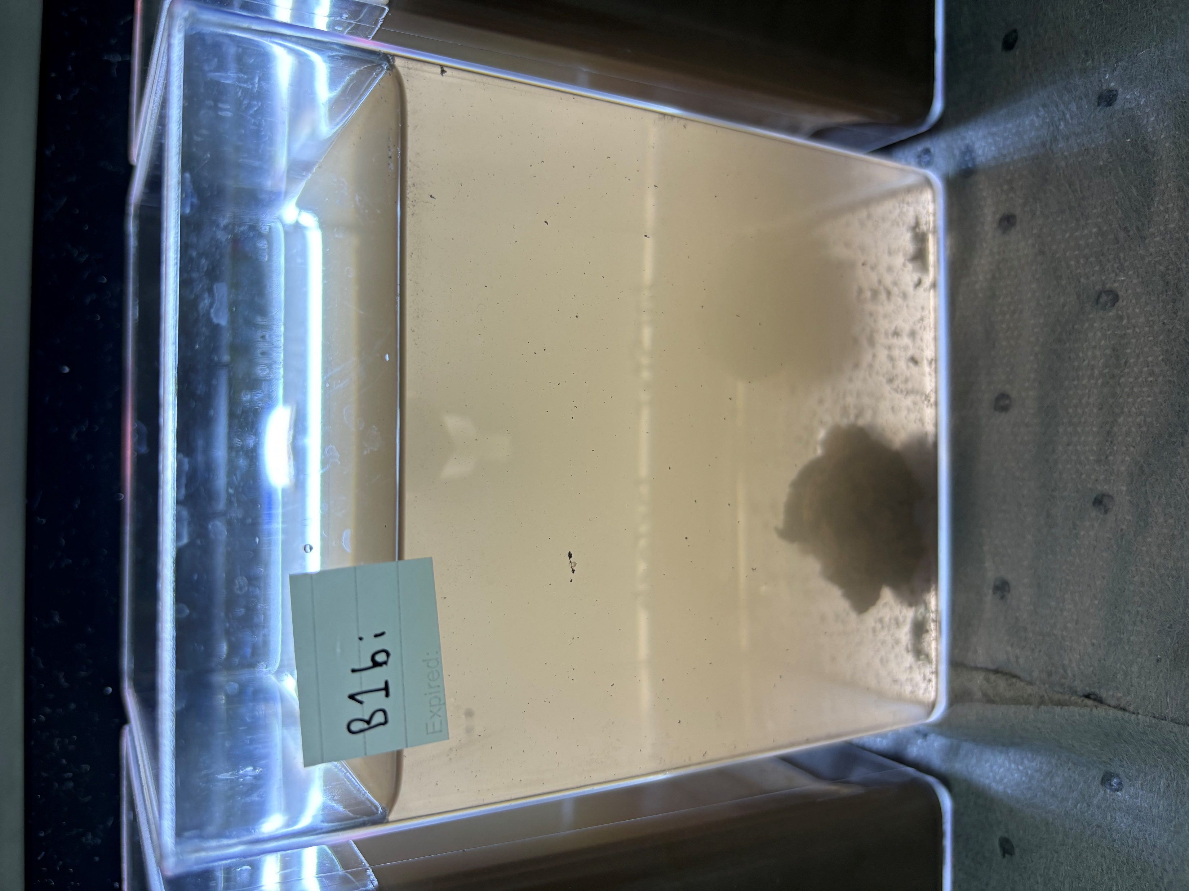
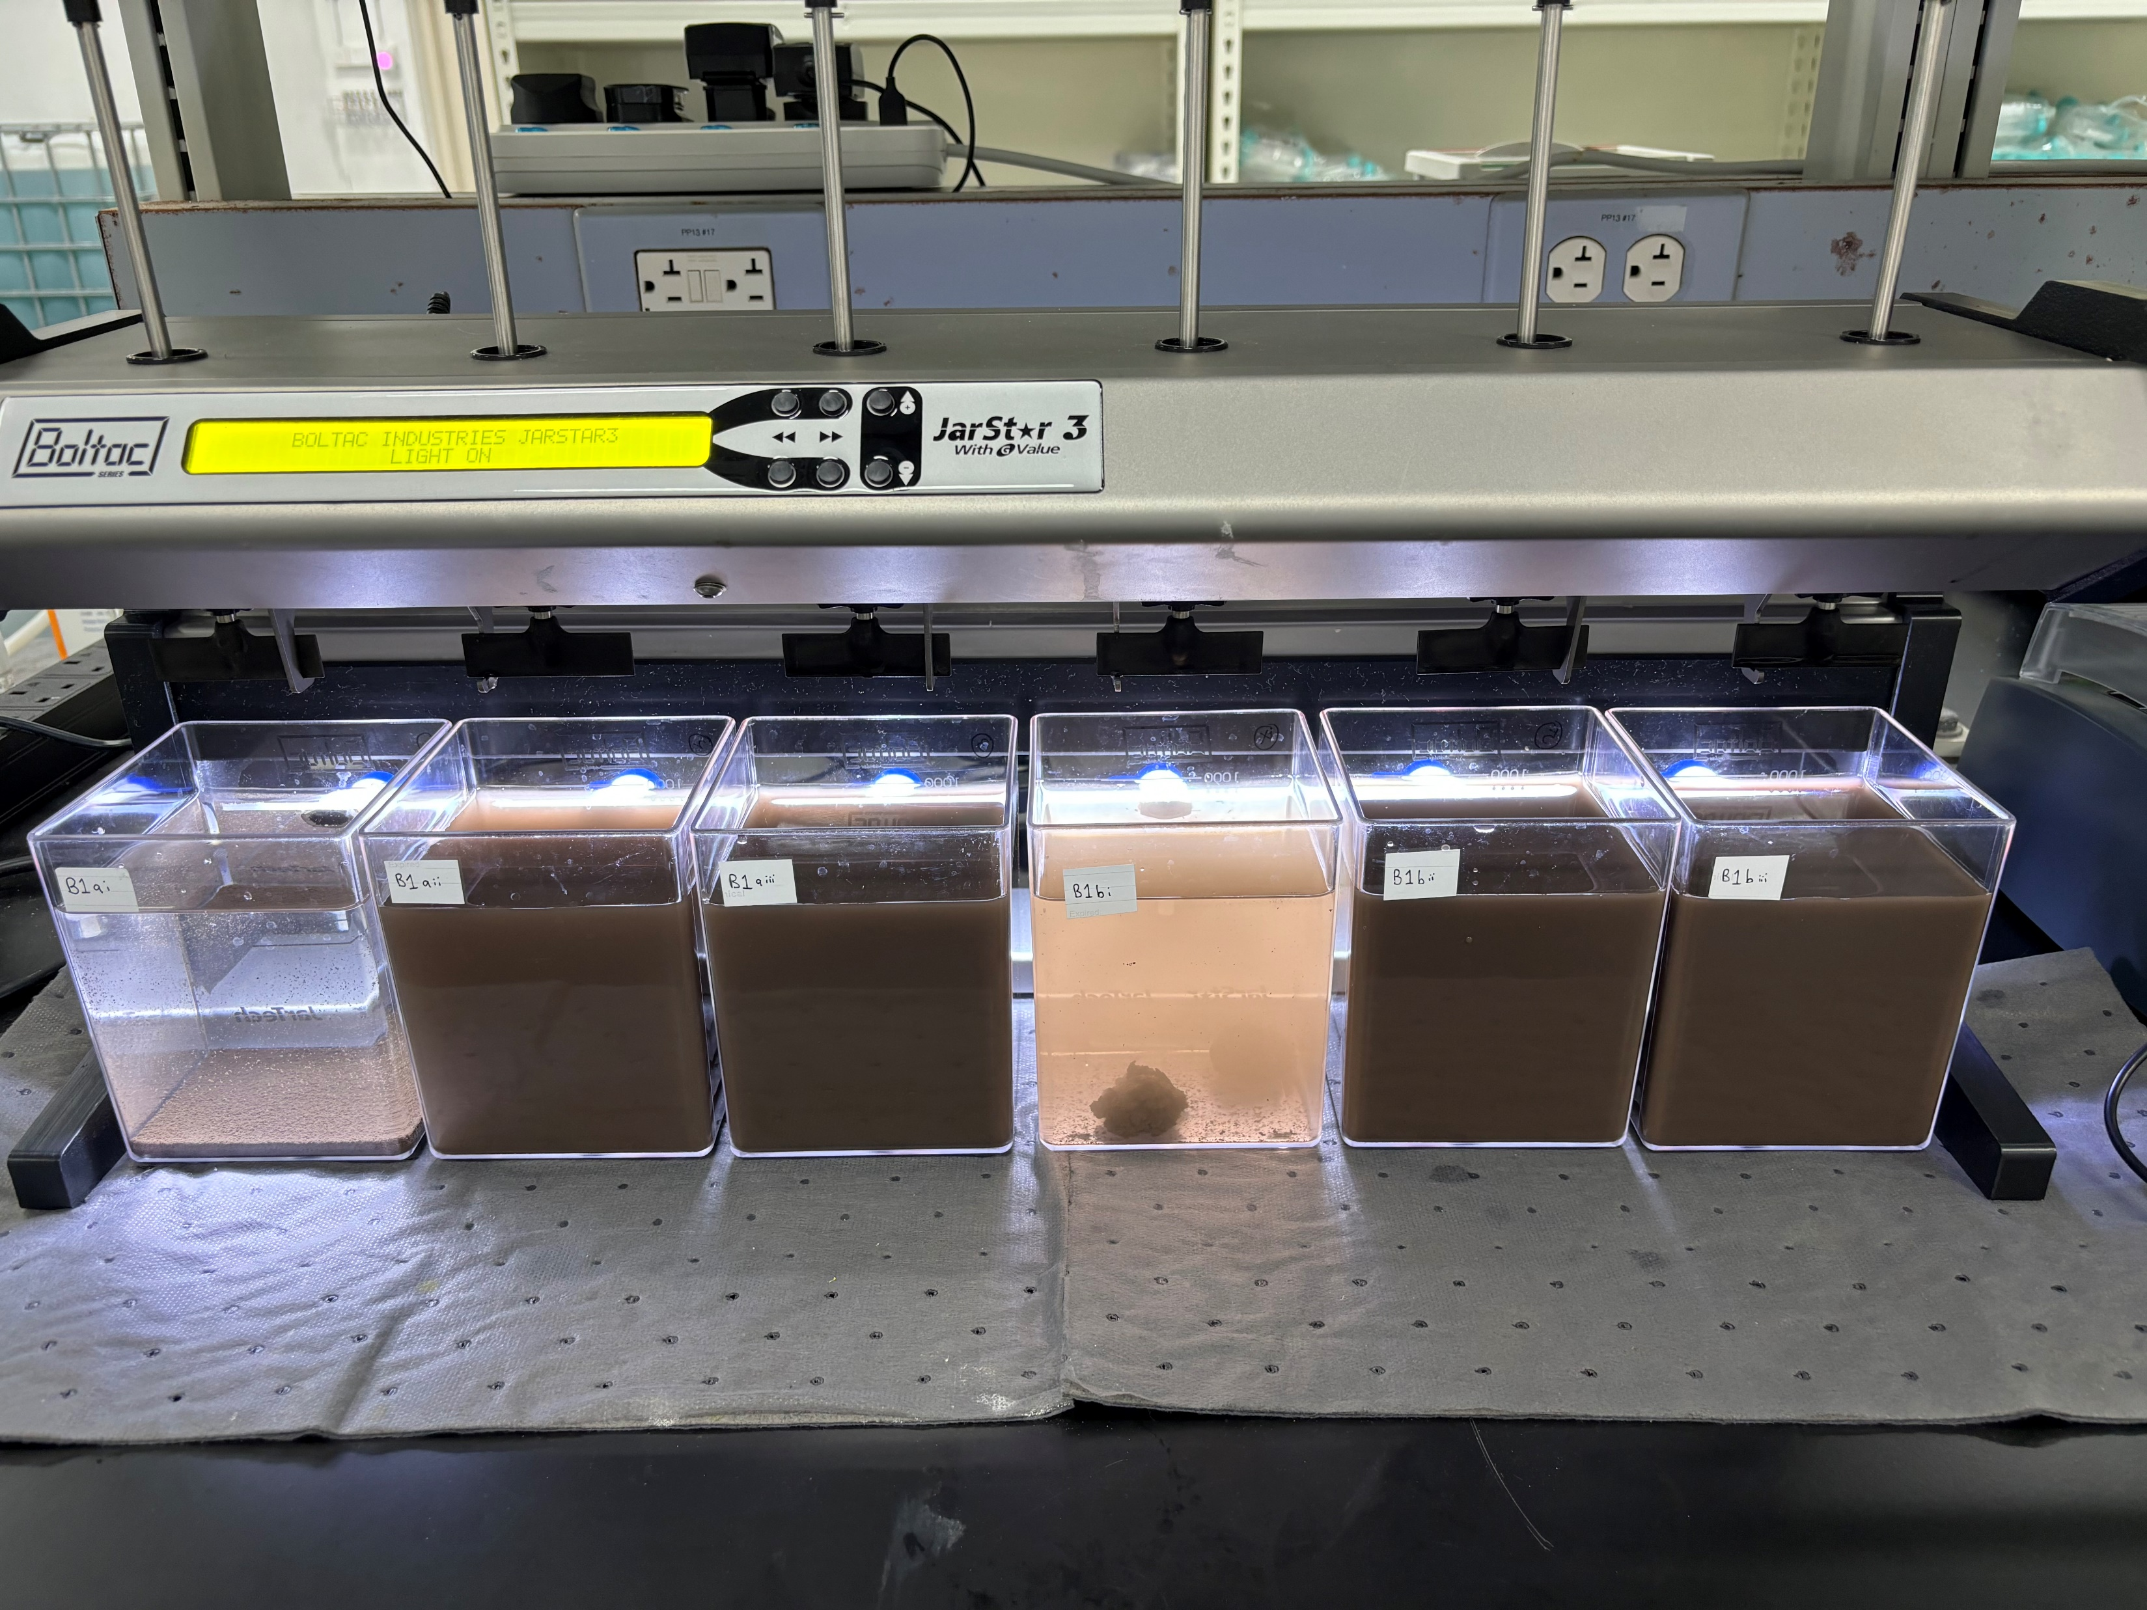
C) 09 Oct 23 Results – Alum with pH correction
Initial
Final
Alum 50mg/L
pH 5.5
Alum 100mg/L
pH 5.5
Alum 50mg/L
Alum 100mg/L
pH: 5.5 6.5 8.5
5.5 6.5 8.5

Slide 9
C) 09 Oct 23 Results – Alum with pH correction
Test B1 – Alum | Control | Alum 50mg/L (pH 5.5) |  | Alum 50mg/L (pH 6.5) |  | Alum 50mg/L (pH 8.5) |  | Alum 100mg/L (pH 5.5) |  | Alum 100mg/L (pH 6.5) |  | Alum 100mg/L (pH 8.5)
 | Feed | Supernatant | *Filtered Supernatant | Supernatant | *Filtered Supernatant | Supernatant | *Filtered Supernatant | Supernatant | *Filtered Supernatant | Supernatant | *Filtered Supernatant | Supernatant | *Filtered Supernatant
pH | 7.51 | 6.58 | 6.33 | 6.7 | 6.81 | 8.98 | 8.94 | 7.38 | 7.18 | 7.38 | 7.27 | 9.63 | 9.6
Turbidity, NTU | 6,820 | 13 | 1.73 | 1,180 | 0.74 | 2,140 | 2.42 | 226 | 1.48 | 4,440 | 0.207 | 5,560 | 0.192
TSS, mg/L | 3,470 | 5 | <3 | 690 | <3 | 1,090 | <3 | 108 | <3 | 2,370 | <3 | 3,050 | <3
Total Silica, mg/L | 560 | 156 | 159 | 268 | 148 | 378 | 142 | 186 | 141 | 479 | 133 | 571 | 126
Conductivity, μS/cm | 42 | 140 | 138 | 170 | 159 | 175 | 178 | 243 | 244 | 264 | 266 | 302 | 312
*Filtered Supernatant (0.45μm)

Slide 10
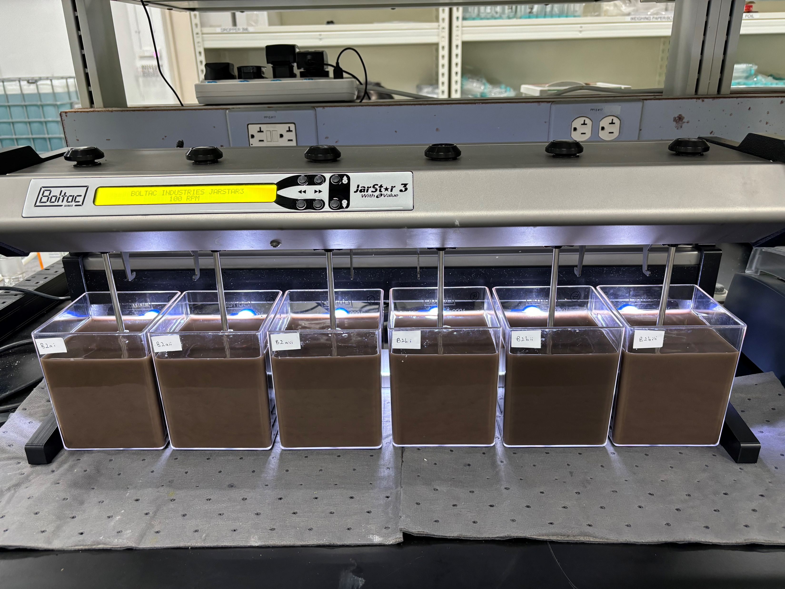
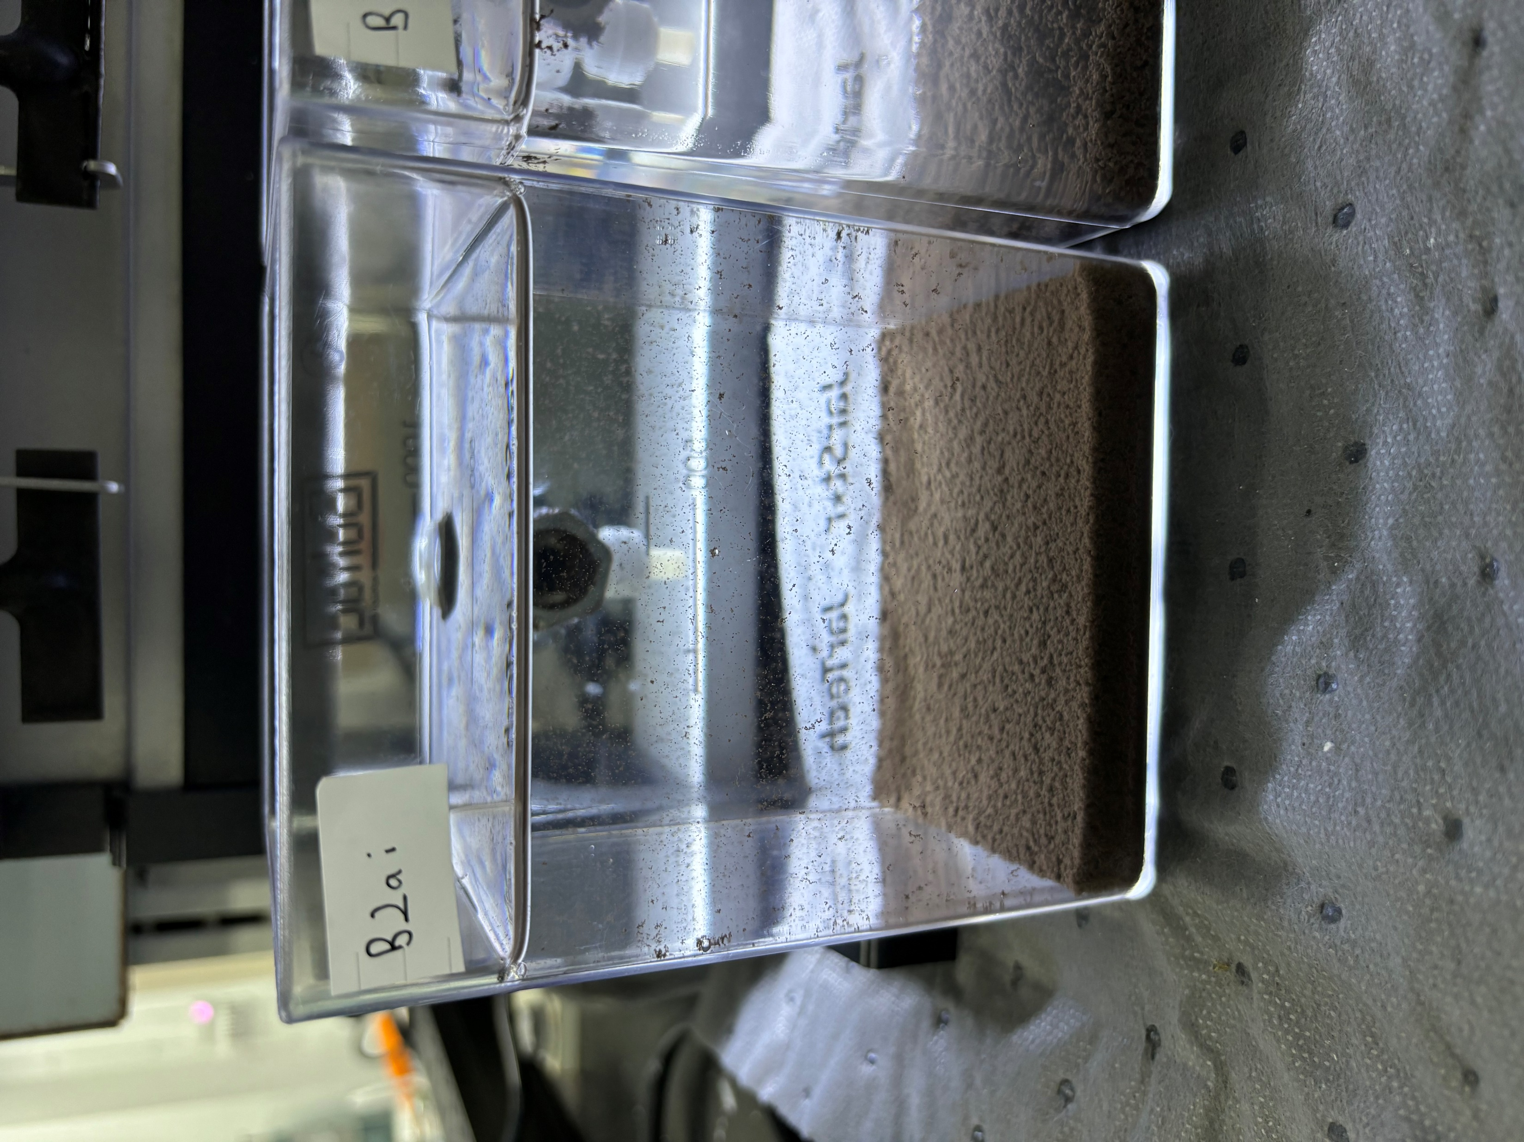
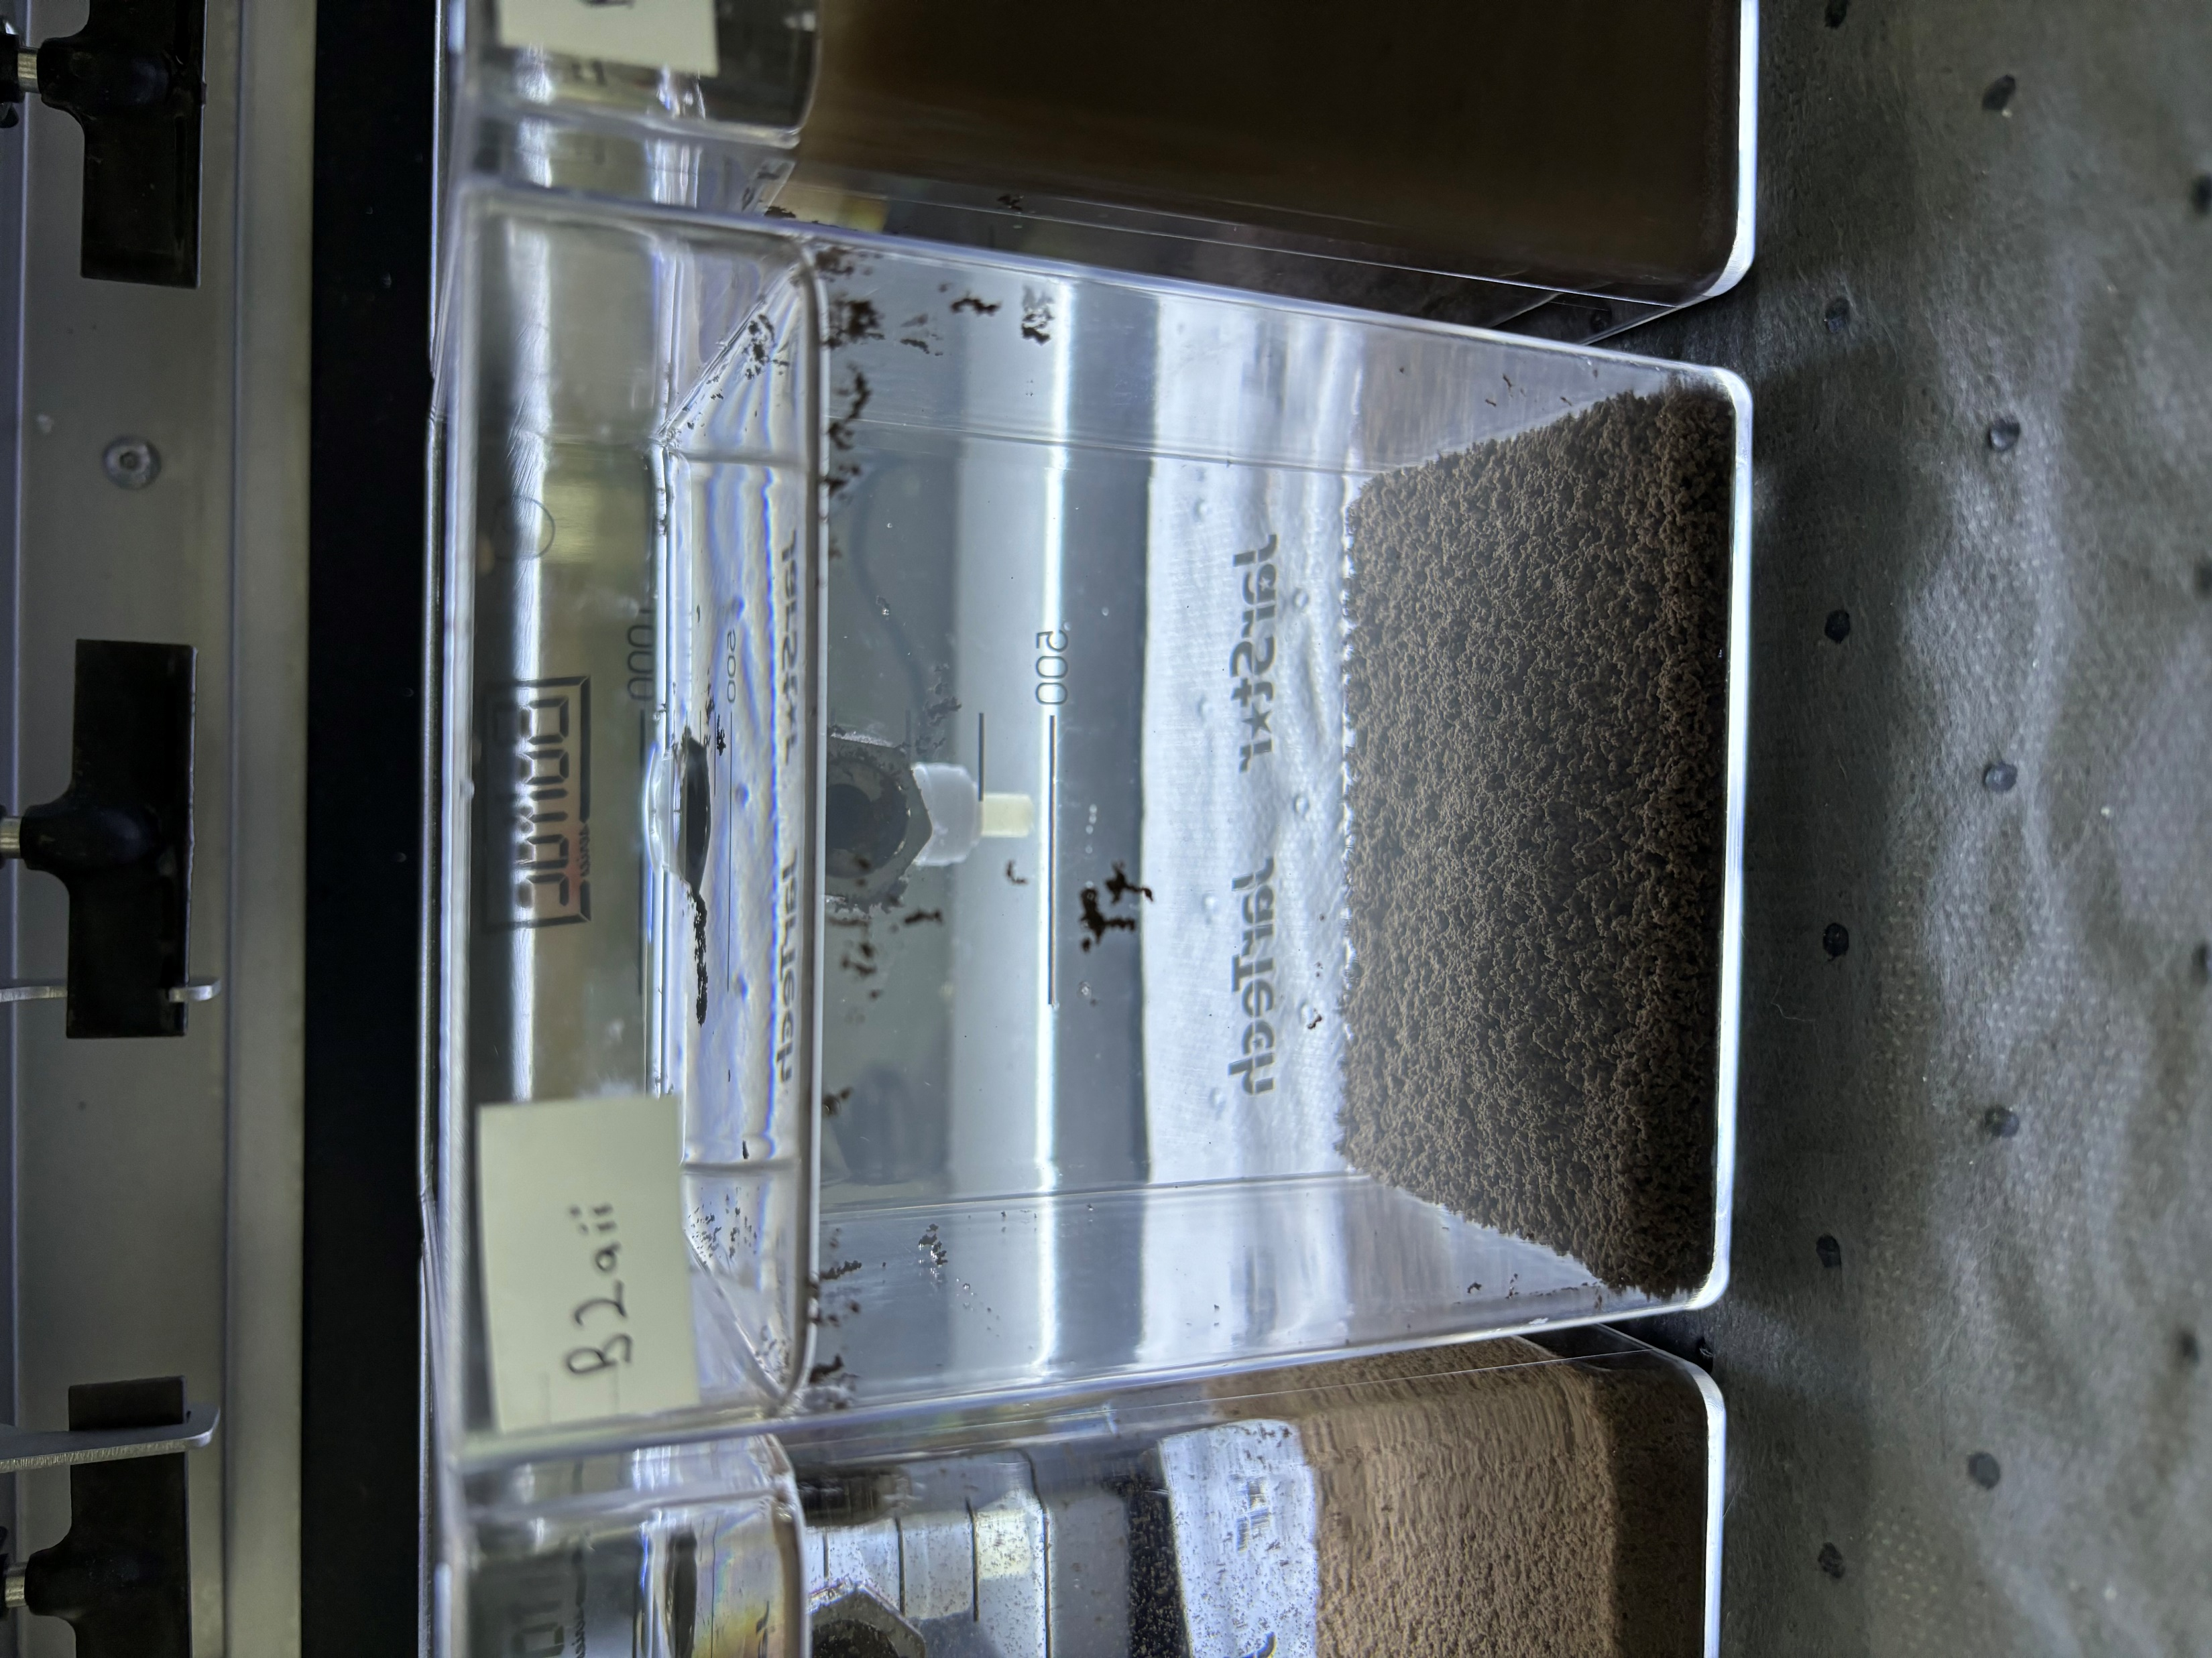
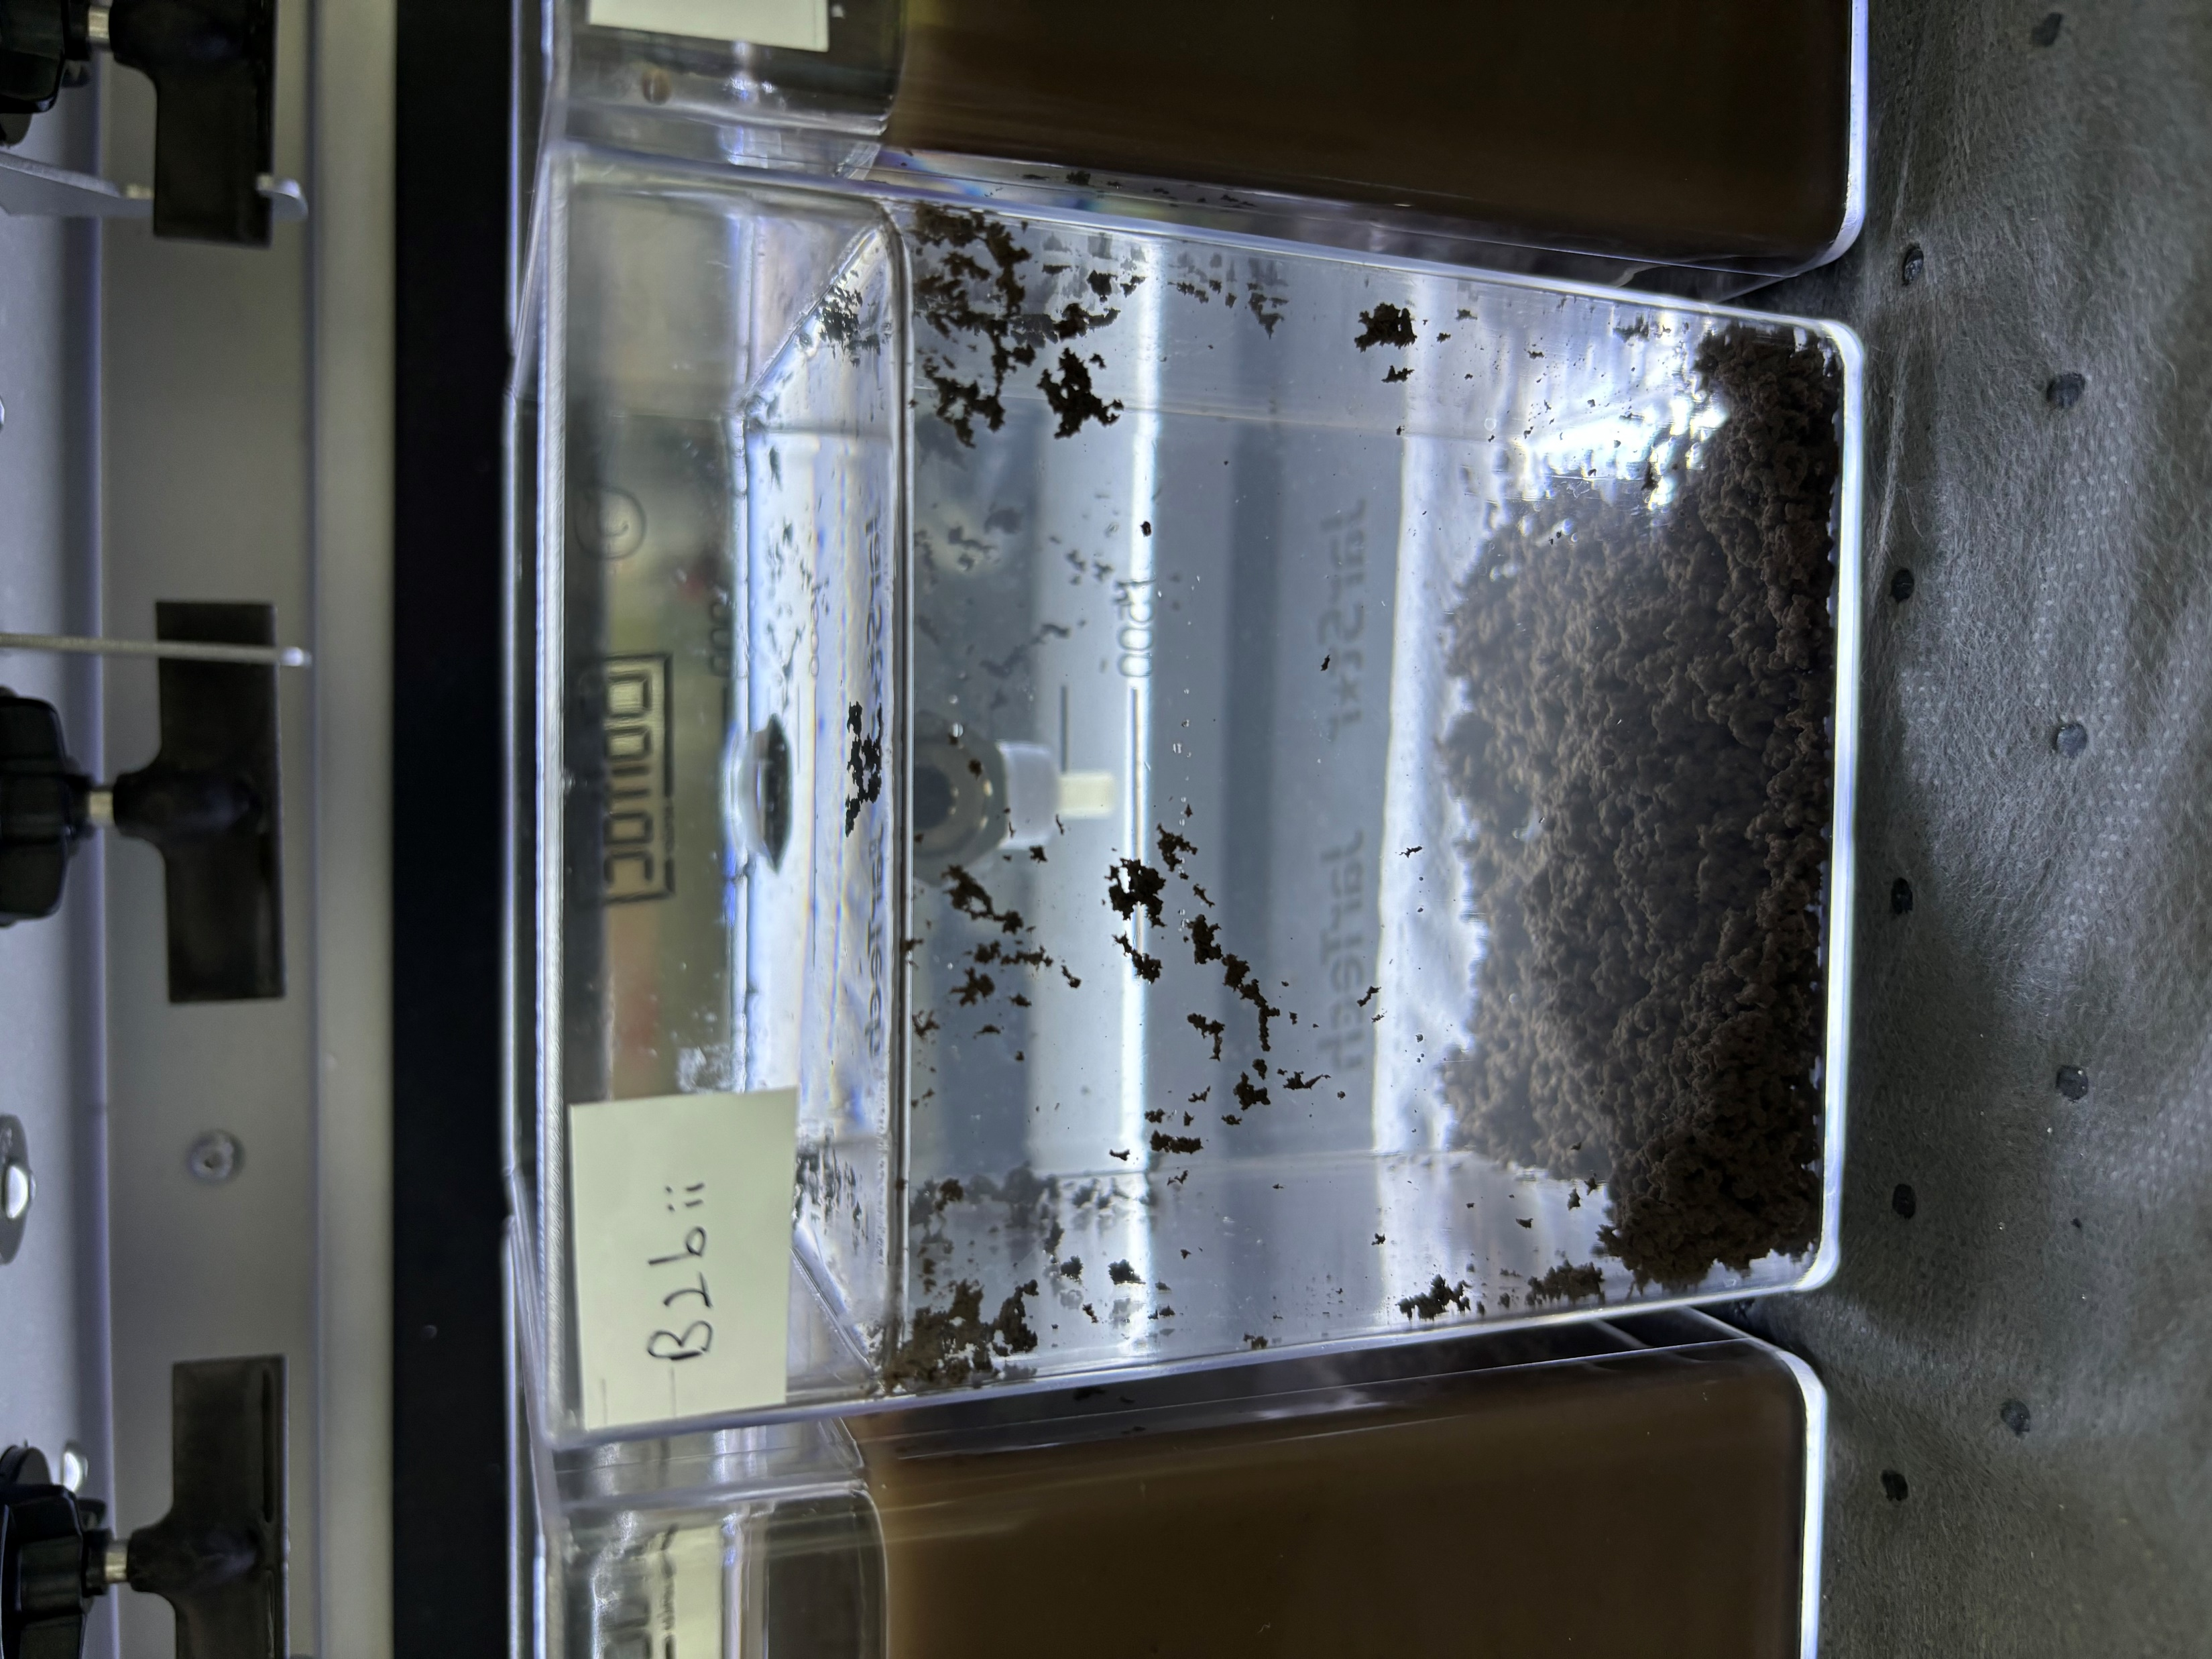
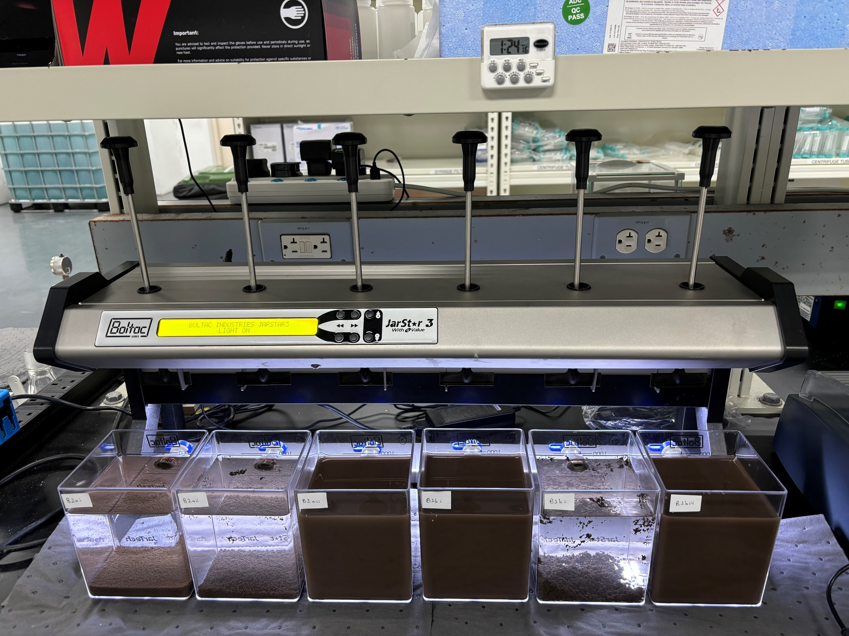
D) 09 Oct 23 Results – PAC with pH correction
Initial
Final
PAC 100mg/L
pH 5.5
PAC 100mg/L
pH 6.5
PAC 150mg/L
pH 6.5
PAC 100mg/L
PAC 150mg/L
pH: 5.5 6.5 8.5
5.5 6.5 8.5

Slide 11
D) 09 Oct 23 Results – PAC with pH correction
Test B2 – PAC | Control | PAC 100mg/L (pH 5.5) |  | PAC 100mg/L (pH 6.5) |  | PAC 100mg/L (pH 8.5) |  | PAC 150mg/L (pH 5.5) |  | PAC 150mg/L (pH 6.5) |  | PAC 150mg/L (pH 8.5)
 | Feed | Supernatant | *Filtered Supernatant | Supernatant | *Filtered Supernatant | Supernatant | *Filtered Supernatant | Supernatant | *Filtered Supernatant | Supernatant | *Filtered Supernatant | Supernatant | *Filtered Supernatant
pH | 6.76 | 5.2 | 5.34 | 6.1 | 6.18 | 6.67 | 6.51 | 4.45 | 4.48 | 5.76 | 5.6 | 7.98 | 8.86
Turbidity, NTU | 6,900 | 5.72 | 0.123 | 25.8 | 0.089 | 3,800 | 0.954 | 6,300 | 0.309 | 22.1 | 0.354 | 6,380 | 1.2
TSS, mg/L | 3,620 | 3 | <3 | 9 | <3 | 1,910 | <3 | 3,270 | <3 | 8 | <3 | 3,360 | <3
Total Silica, mg/L | 570 | 157 | 156 | 157 | 156 | 405 | 147 | 537 | 151 | 149 | 144 | 561 | 140
Conductivity, μS/cm | 34.4 | 130 | 128 | 129 | 129 | 149 | 155 | 183 | 182 | 179 | 181 | 204 | 206
*Filtered Supernatant (0.45μm)

Slide 12
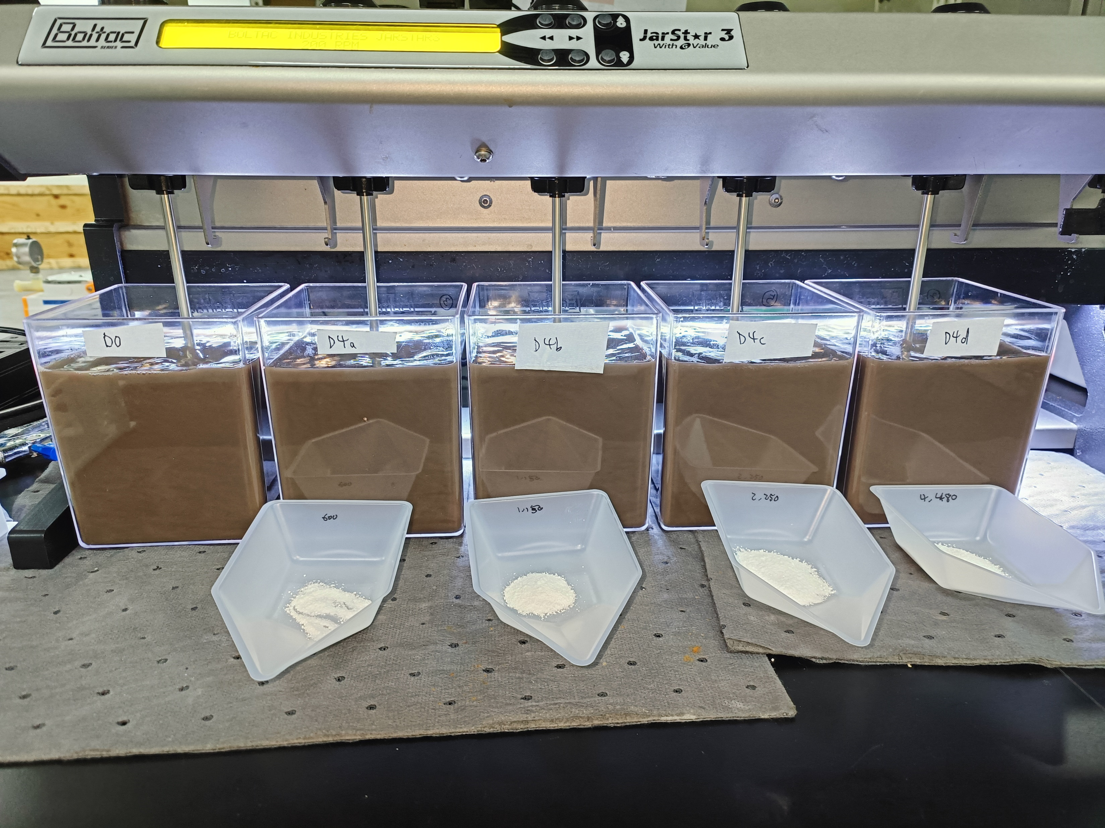
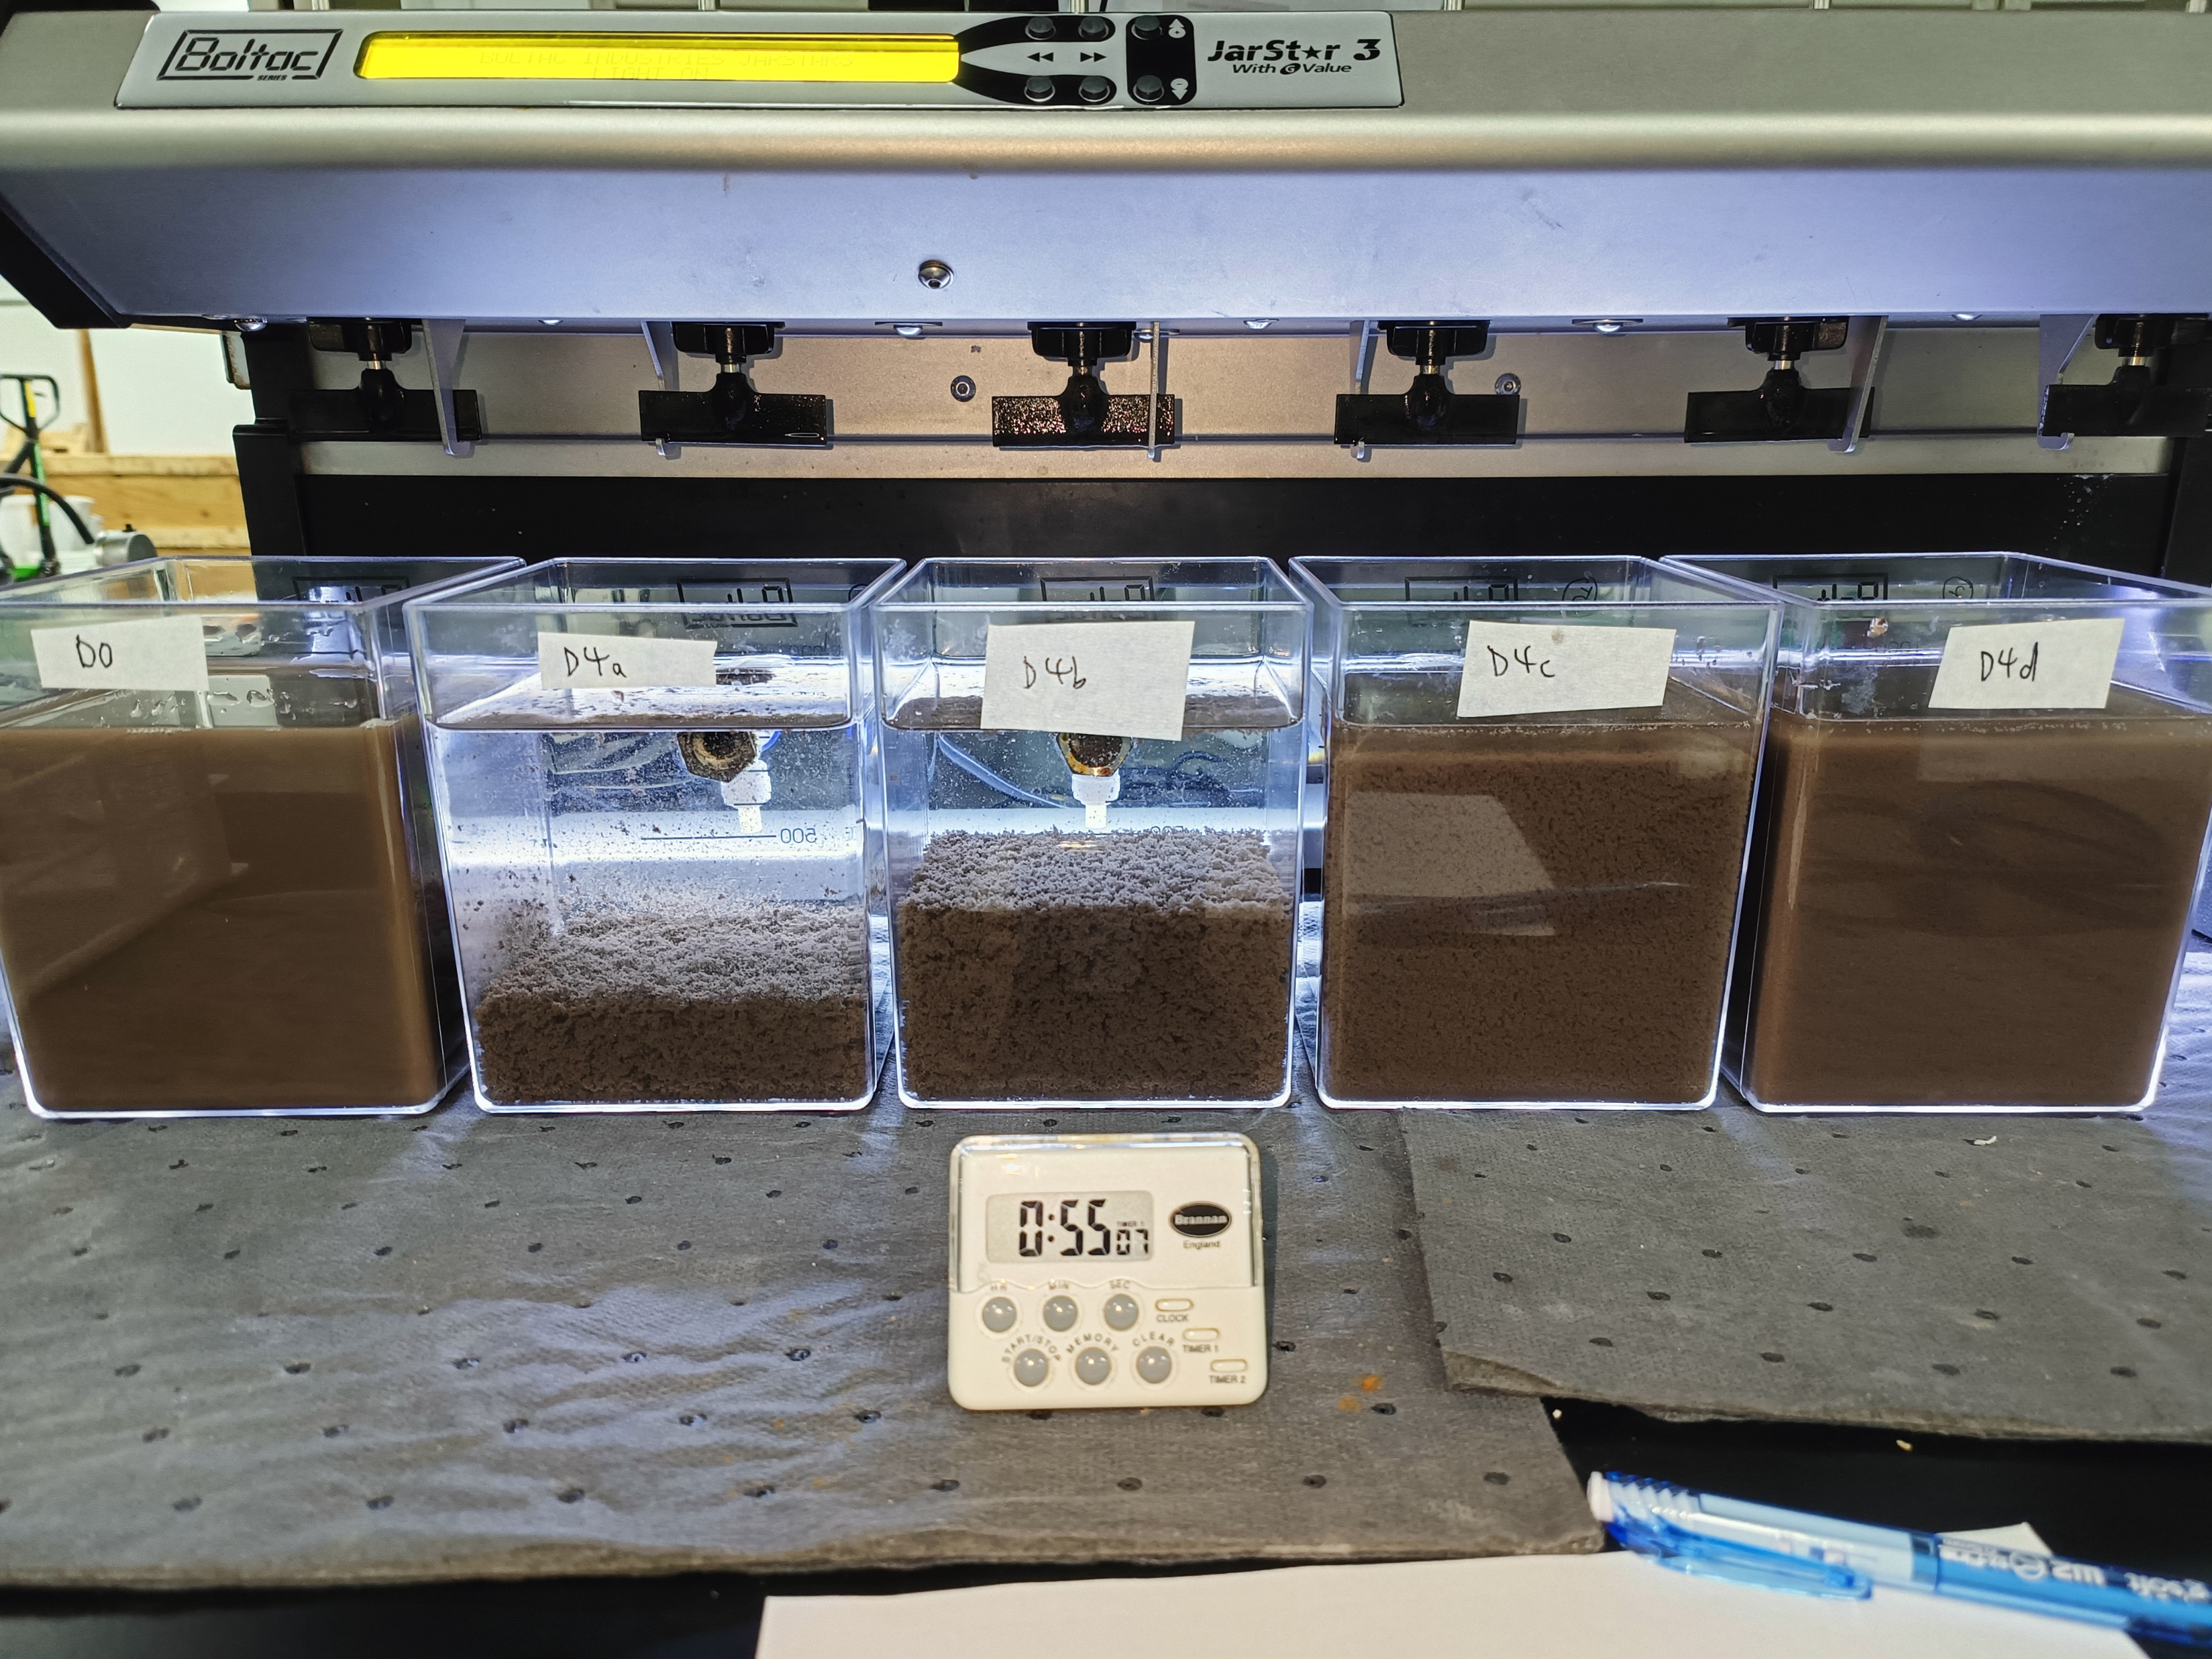
E) 22 Dec 2023 – MgCl2 with pH correction
Initial
Beginning of settling
Control
MgCl2 600mg/L
MgCl2 1,150mg/L
MgCl2 2,250mg/L
MgCl2 4,480mg/L
Control
MgCl2 600mg/L
MgCl2 1,150mg/L
MgCl2 2,250mg/L
MgCl2 4,480mg/L
pH 10.5
pH 10.5

Slide 13
E) 22 Dec 2023 – MgCl2 with pH correction
 | (1) Control | (2) MgCl2 - 600mg/L | (3) MgCl2 – 1,150mg/L | (4) MgCl2 – 2,250mg/L | (5) MgCl2 – 4,480mg/L
 | Feed | Supernatant | Supernatant | Supernatant | Supernatant
Mg:SiO2 | - | 0.4 | 0.8 | 1.6 | 3.2
pH | 6.61 | 9.96 | 10.05 | 9.88 | 9.86
Turbidity, NTU | 5,970 | 0.61 | 1.42 | 1.11 | 8.35
TSS, mg/L | 3,100 | <3 | <3 | <3 | 10
Total Silica, mg/L | 361 | 11.2 | 3.32 | 2.76 | 4.91
Dissolved Silica, mg/L | 170 | 11.3 | 2.55 | 1.57 | 1.8
Conductivity, μS/cm | 20.6 | 1,264 | 2,299 | 4,243 | 8,067
TDS, mg/L | 32.72 | 883.7 | 1,675 | 3,236 | 6,552
Mg, mg/L | <1 | 24.2 | 89.7 | 169 | 193
Cl, mg/L | 3.3 | 347 | 650 | 1,216 | 2,491

Slide 14
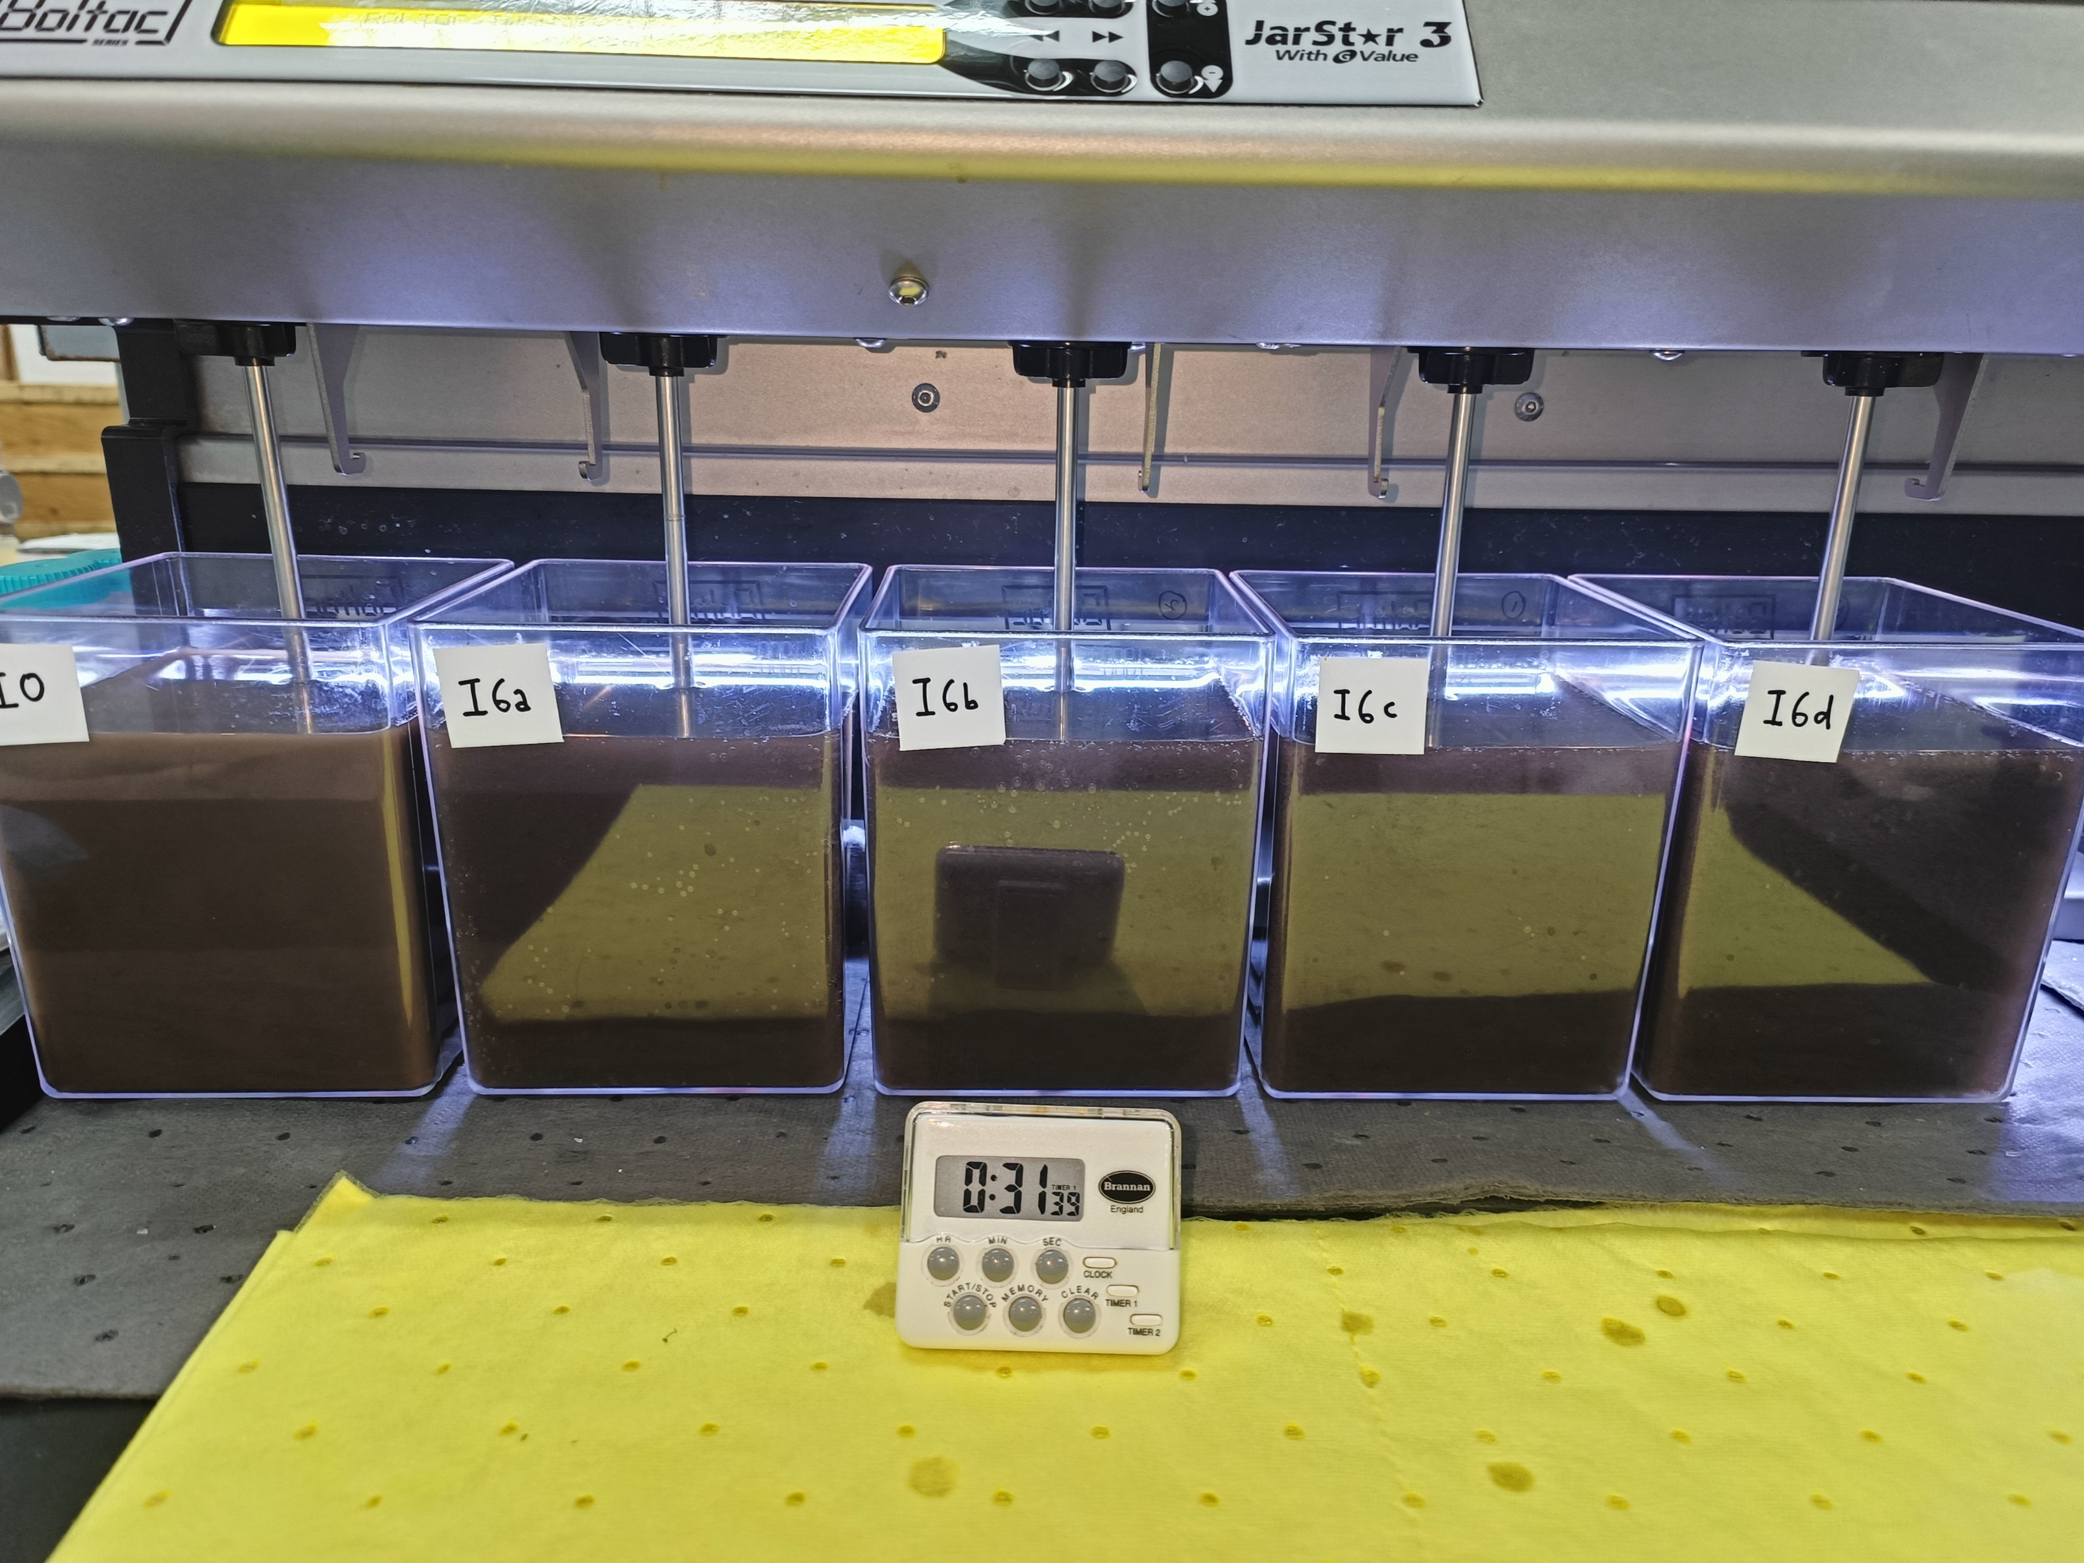
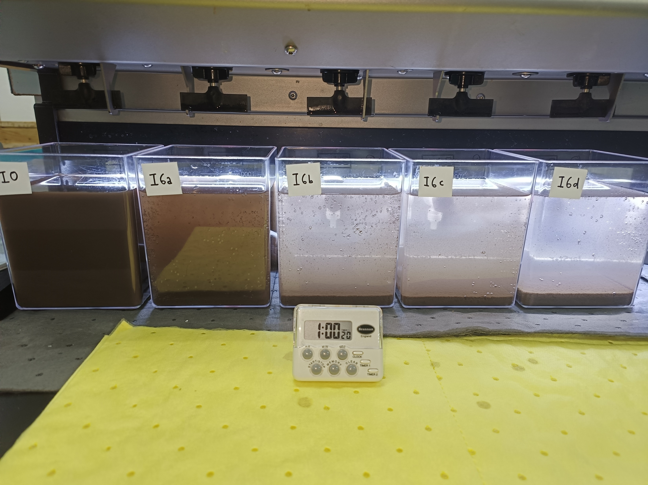
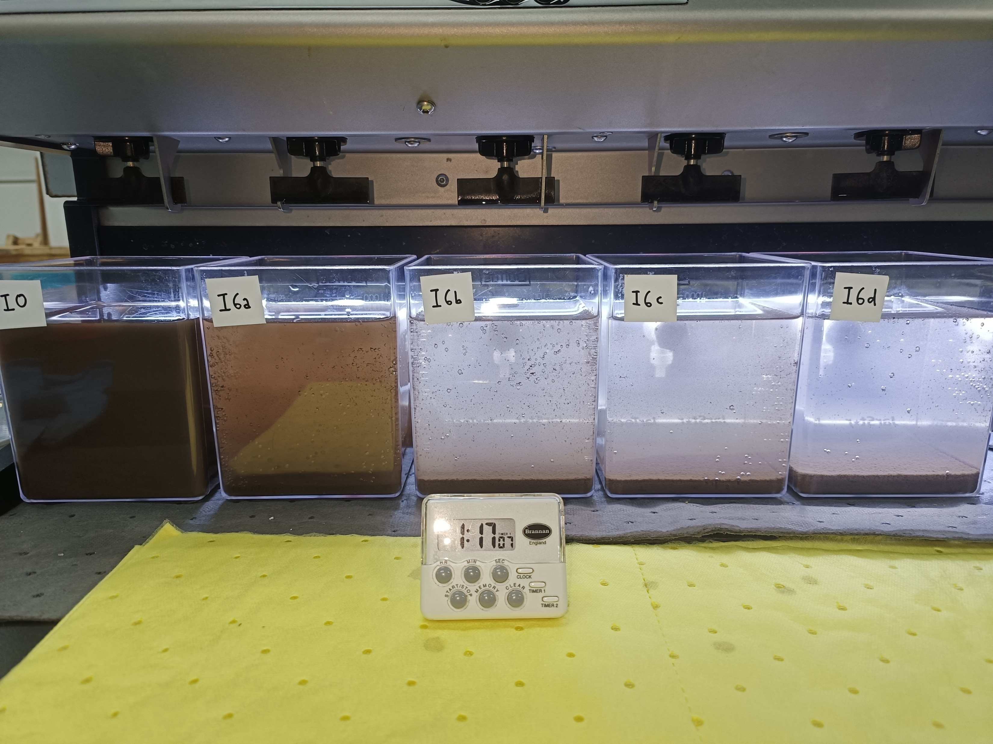
F) 02 Jan 2023 – pH-corrected feed; simultaneous PolyDADMAC & MgCl2 dosing
Polymer addition
Initial feed pH correction
Volume of 10% NaOH added to 2,500mL:
~4.5 mL
pH:
7.8 → 11.0
Settling 15 mins
Settling 30 mins

Slide 15
F) 02 Jan 2023 – Simultaneous PolyDADMAC & MgCl2 dosing
 | (1) Control | (2) PolyDM 50mg/L & MgCl2 200mg/L | (3) PolyDM 50mg/L & MgCl2 300mg/L | (4) PolyDM 100mg/L & MgCl2 200mg/L | (5) PolyDM 100mg/L & MgCl2 300mg/L
 | Feed | Supernatant | Supernatant | Supernatant | Supernatant
Mg:SiO2 | - | 0.09 | 0.13 | 0.09 | 0.13
pH | 10.2 | 10.6 | 10.7 | 10.7 | 10.8
Turbidity, NTU | - | - | - | - | -
TSS, mg/L | - | - | - | - | -
Total Silica, mg/L | 581 | 253 | 164 | 212 | 159
Dissolved Silica, mg/L | - | - | - | - | -
Conductivity, μS/cm | 331 | 746 | 922 | 774 | 950
TDS, mg/L | 237 | 494 | 618 | 511 | 638
Mg, mg/L | <1 | <1 | <1 | <1 | <1
Cl, mg/L | 13.9 | 117 | 180 | 125 | 185

Slide 16
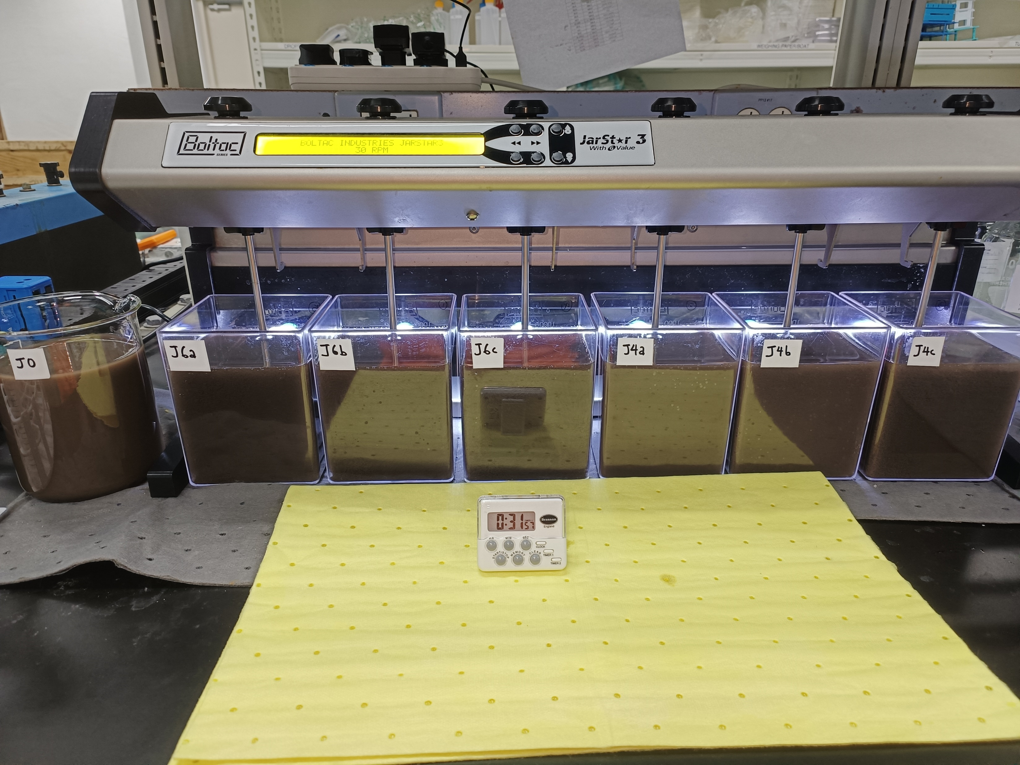
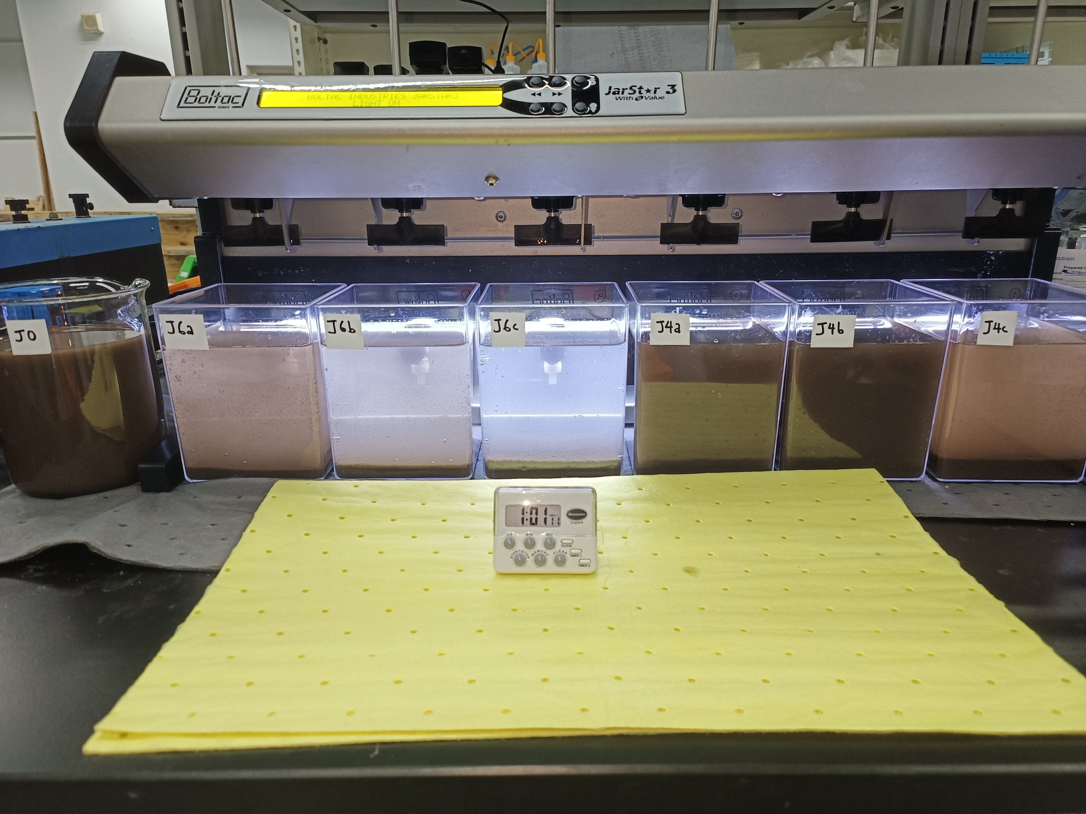
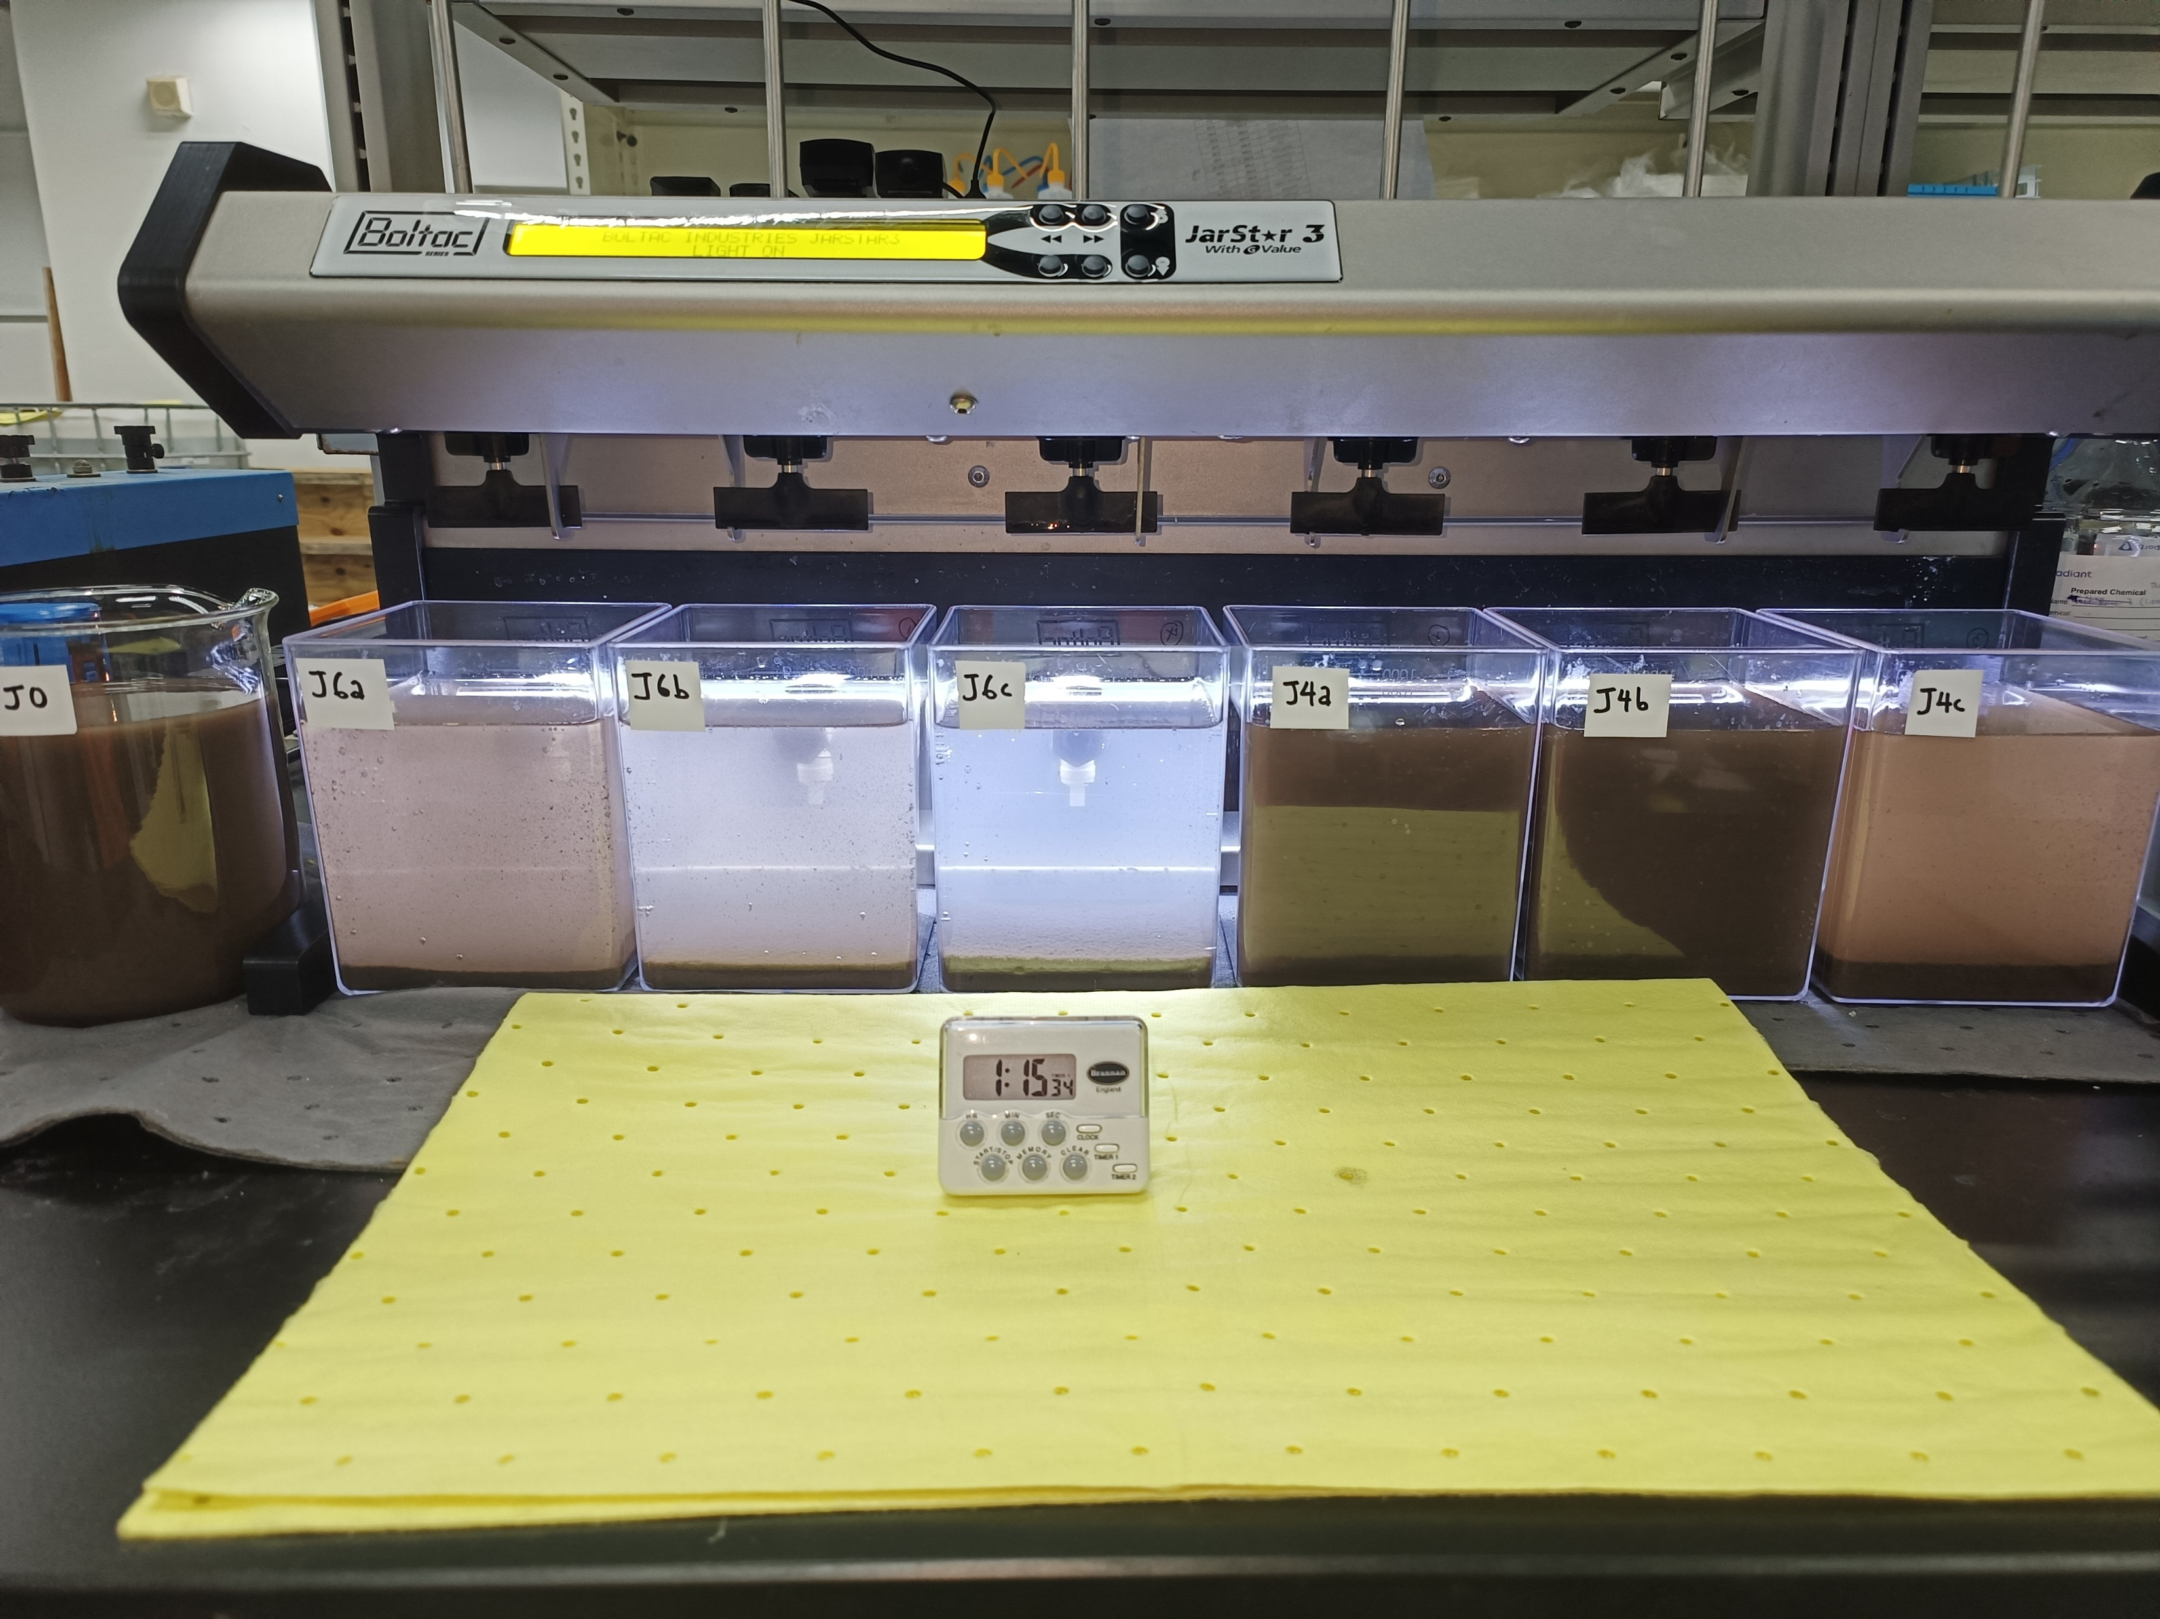
G) 04 Jan 2023 – pH-corrected feed; sequential PolyDADMAC & MgCl2 dosing
Polymer addition
Initial feed pH correction
Volume of 10% NaOH added to 6,500mL:
~6.5 mL
pH:
8.0 → 11.0
Settling 15 mins
Settling 30 mins

Slide 17
G) 04 Jan 2023 – Sequential PolyDADMAC & MgCl2 dosing
 | (1a) Control | (1b) Control – pH11 | (2) PolyDM 50mg/L & MgCl2 200mg/L | (3) PolyDM 50mg/L & MgCl2 300mg/L | (4) PolyDM 50mg/L & MgCl2 400mg/L | (5) MgCl2 200mg/L | (6) MgCl2 300mg/L | (7) MgCl2 400mg/L
 | Feed | Feed | Supernatant | Supernatant | Supernatant | Supernatant | Supernatant | Supernatant
Mg:SiO2 | - | - | 0.09 | 0.13 | 0.17 | 0.09 | 0.13 | 0.17
pH | 7.8 | 10.1 | 10.5 | 10.5 | 10.4 | 10.5 | 10.4 | 10.4
Turbidity, NTU | 4,905 | 2,660 | 148 | 90.5 | 48 | 888 | 840 | 235
TSS, mg/L | 2,895 | 1,425 | 77 | 49 | 27 | 471 | 453 | 128
Total Silica, mg/L | 540 | 588 | 226 | 169 | 141 | 327 | 286 | 164
Dissolved Silica, mg/L | - | - | - | - | - | - | - | -
Conductivity, μS/cm | 50 | 339 | 753 | 912 | 1,061 | 739 | 888 | 1,034
TDS, mg/L | 31.7 | 224 | 515 | 630 | 739 | 505 | 612 | 719
Mg, mg/L | <1 | <1 | 4.71 | 8.06 | 7.89 | 7.75 | 12.5 | 3.23
Cl, mg/L | 13.8 | 13.9 | 120 | 179 | 242 | 115 | 173 | 236

Slide 18
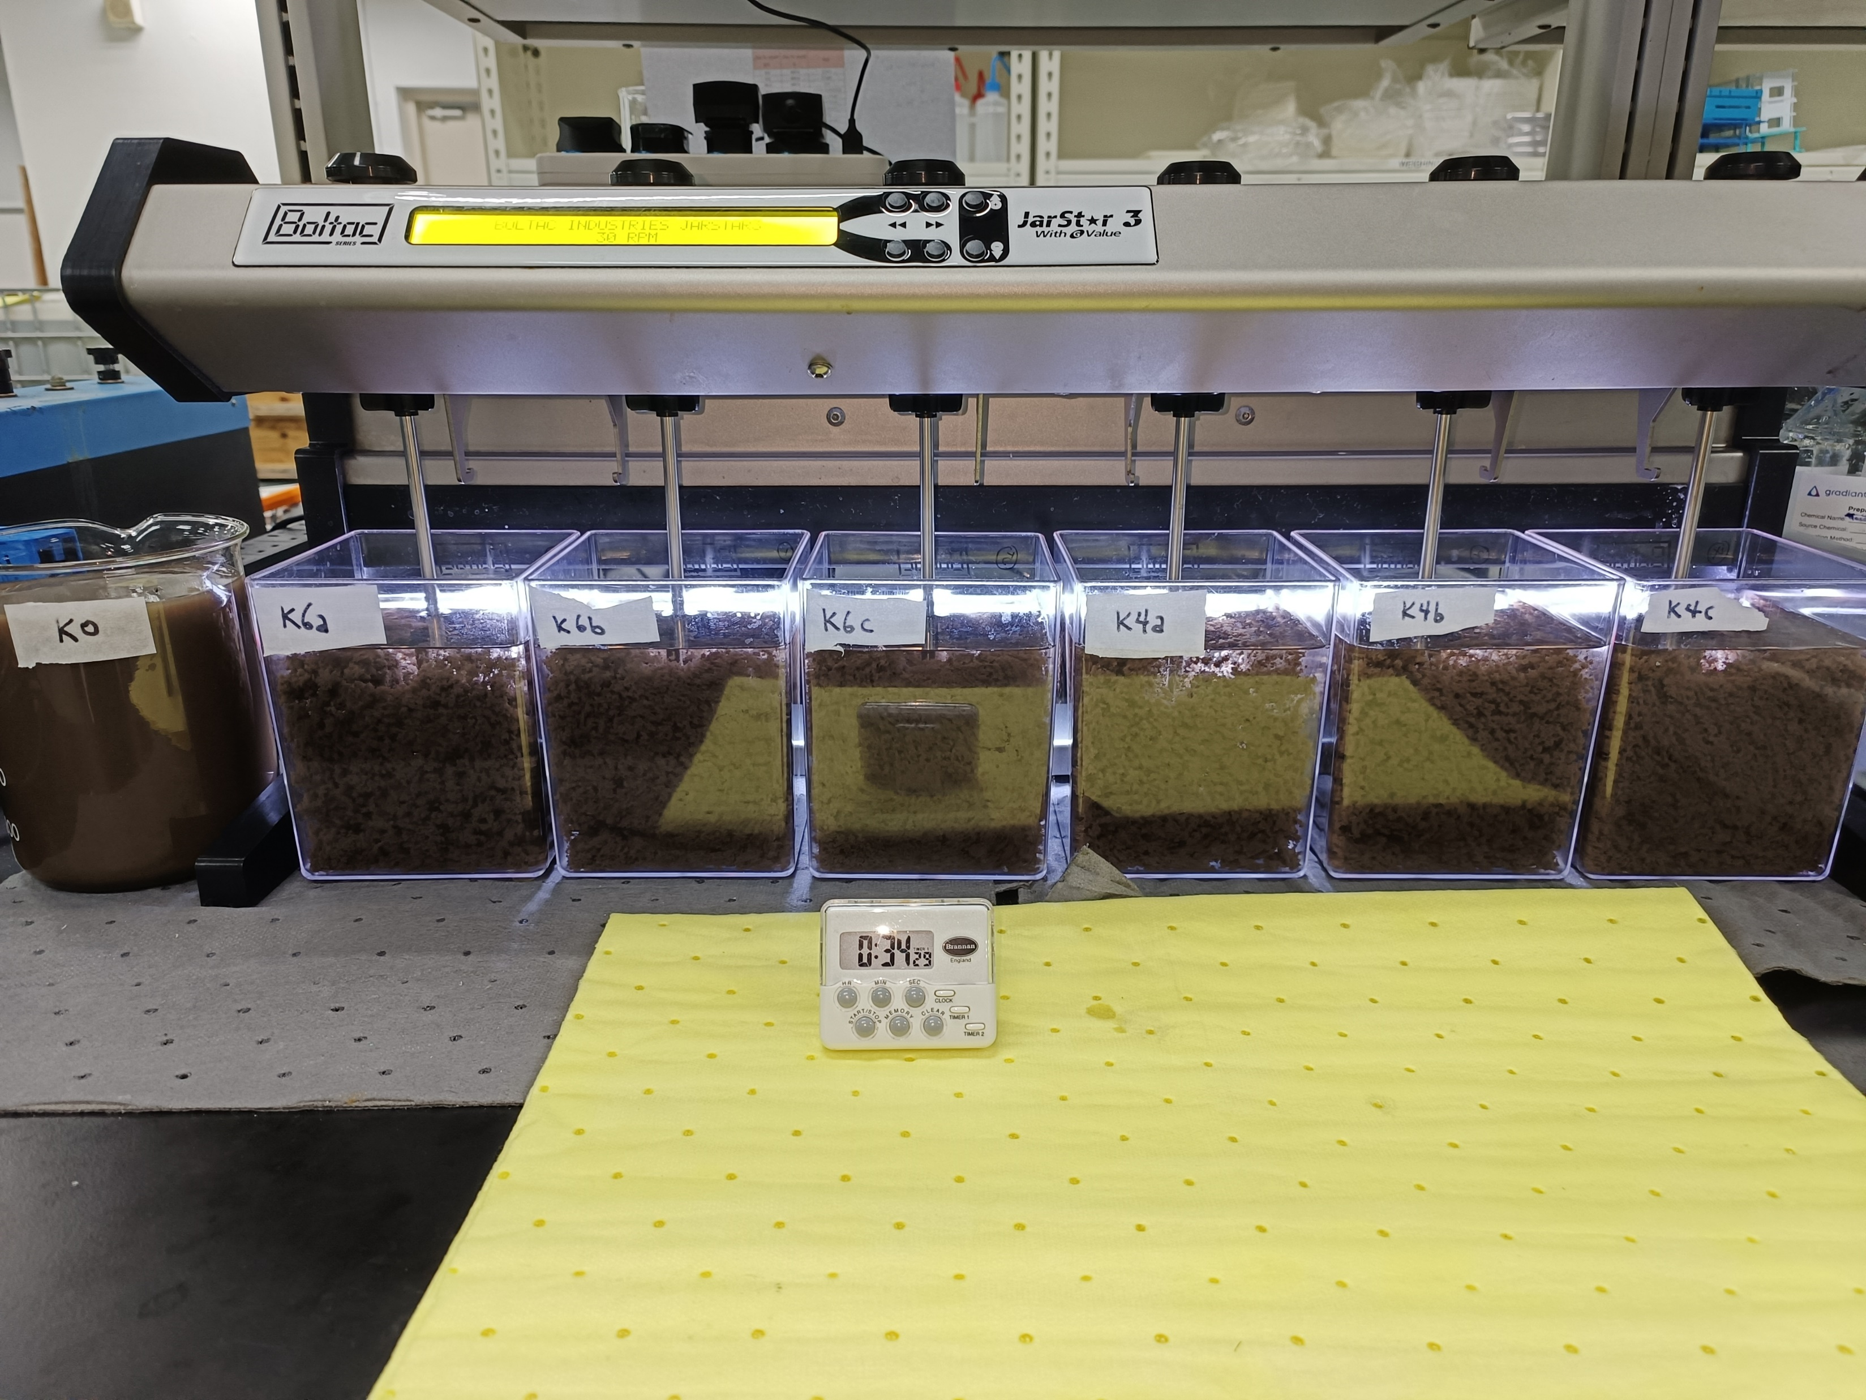
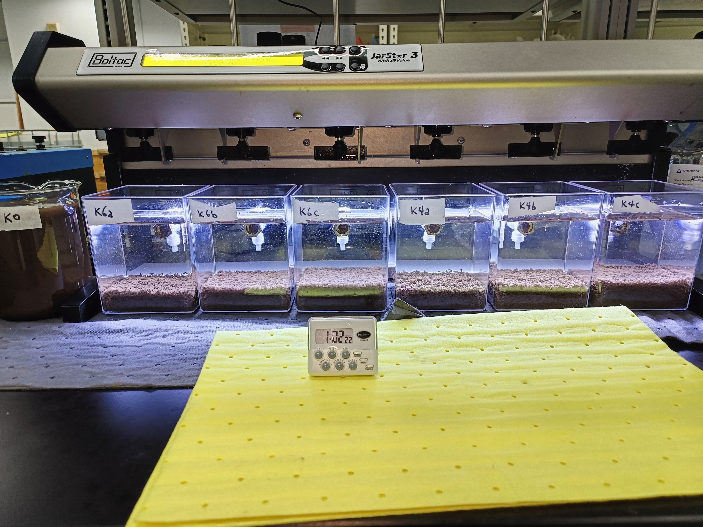
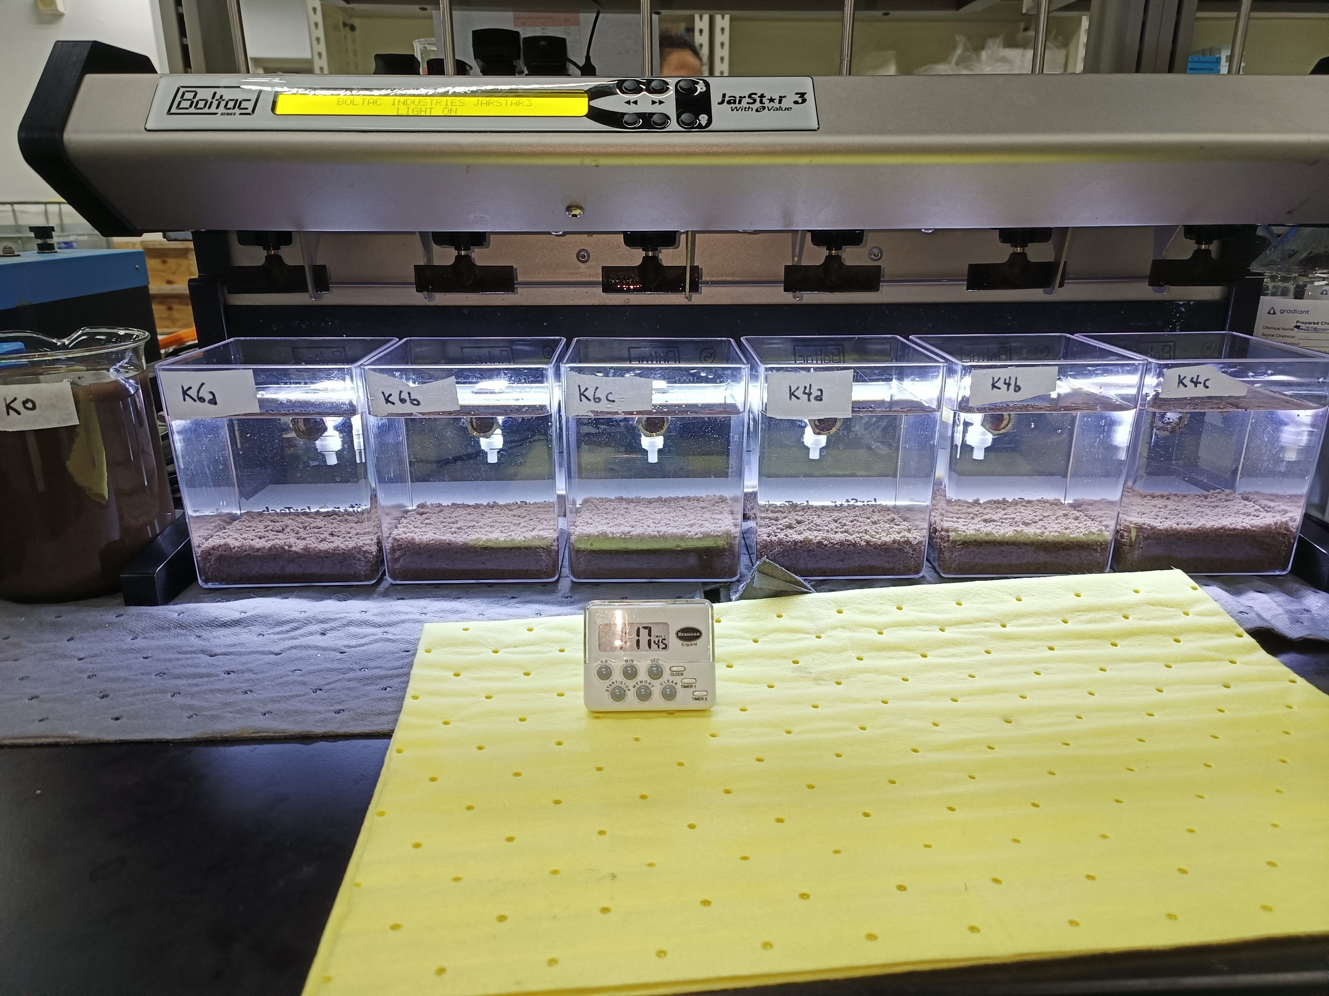
H) 10 Jan 2023 – pH-corrected feed; sequential PolyDADMAC & MgCl2 dosing
Polymer addition
Initial feed pH correction
Volume of 10% NaOH added to 6,500mL:
~5.5 mL
pH:
8.8 → 11.1
Settling 15 mins
Settling 30 mins

Slide 19
H) 10 Jan 2023 – Sequential PolyDADMAC & MgCl2 dosing
 | (1a) Control | (1b) Control – pH11 | (2) PolyDM 25mg/L & MgCl2 705mg/L | (3) PolyDM 25mg/L & MgCl2 825mg/L | (4) PolyDM 25mg/L & MgCl2 940mg/L | (5) MgCl2 705mg/L | (6) MgCl2 825mg/L | (7) MgCl2 940mg/L
 | Feed | Feed | Supernatant | Supernatant | Supernatant | Supernatant | Supernatant | Supernatant
Mg:SiO2 | - | - | 0.36 | 0.42 | 0.48 | 0.36 | 0.42 | 0.48
pH | 8.8 | 10.3 | 10.5 | 10.5 | 10.5 | 10.6 | 10.5 | 10.6
Turbidity, NTU | 3,400 | 2,540 | 0.806 | 1.89 | 2.37 | 1.21 | 0.82 | 0.806
TSS, mg/L | 1,716 | 1,368 | <3 | <3 | <3 | <3 | <3 | <3
Total Silica, mg/L | 493 | 510 | 10.6 | 4.88 | 2.87 | 6.22 | 4.21 | 2.70
Dissolved Silica, mg/L | 247 | 463 | 10.3 | 5.36 | 2.98 | 6.27 | 4.15 | 2.78
Conductivity, μS/cm | 68.9 | 324 | 1,605 | 1,816 | 2,060 | 1,613 | 1,798 | 2,060
^TDS, mg/L | 410 | 600 | 741 | 860 | 1,106 | 731 | 834 | 957
Mg, mg/L | 1.2 | 1.15 | 7.31 | 10.2 | 14.3 | 10.9 | 12.2 | 13.4
Cl, mg/L | 14.3* | 14.2* | 410 | 481 | 599 | 414 | 485 | 574
^TDS using gravimetric method, instead of Ultrameter
*filtered through 0.45μm to remove suspended solids

Slide 20
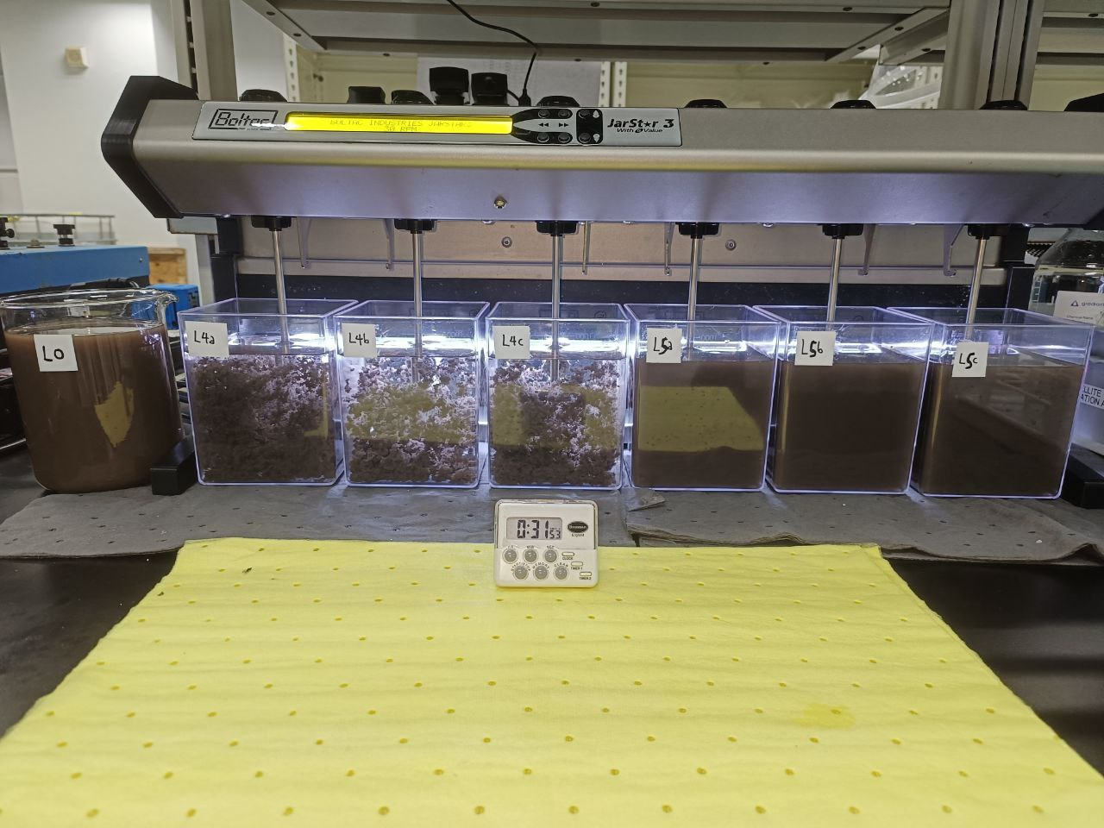
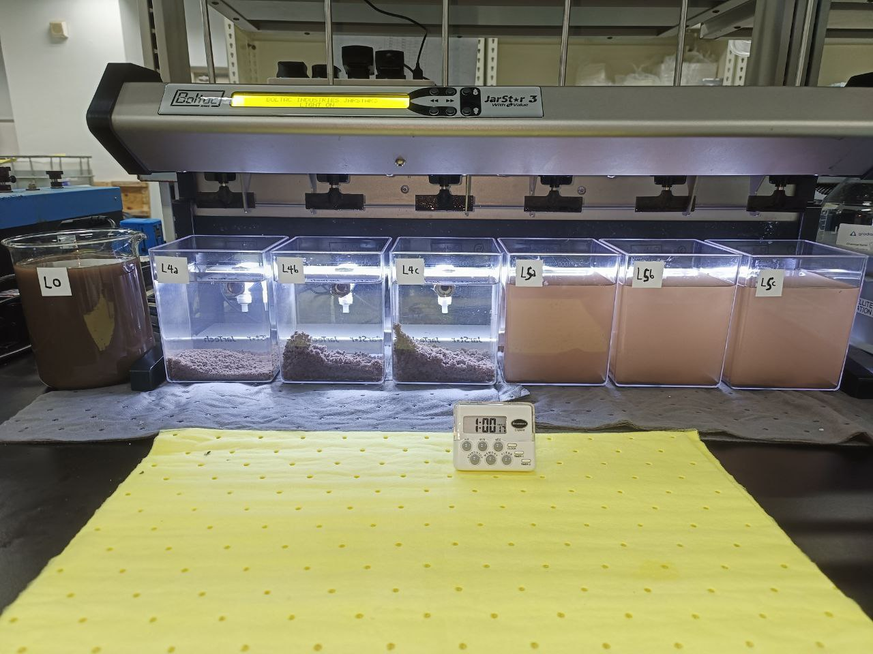
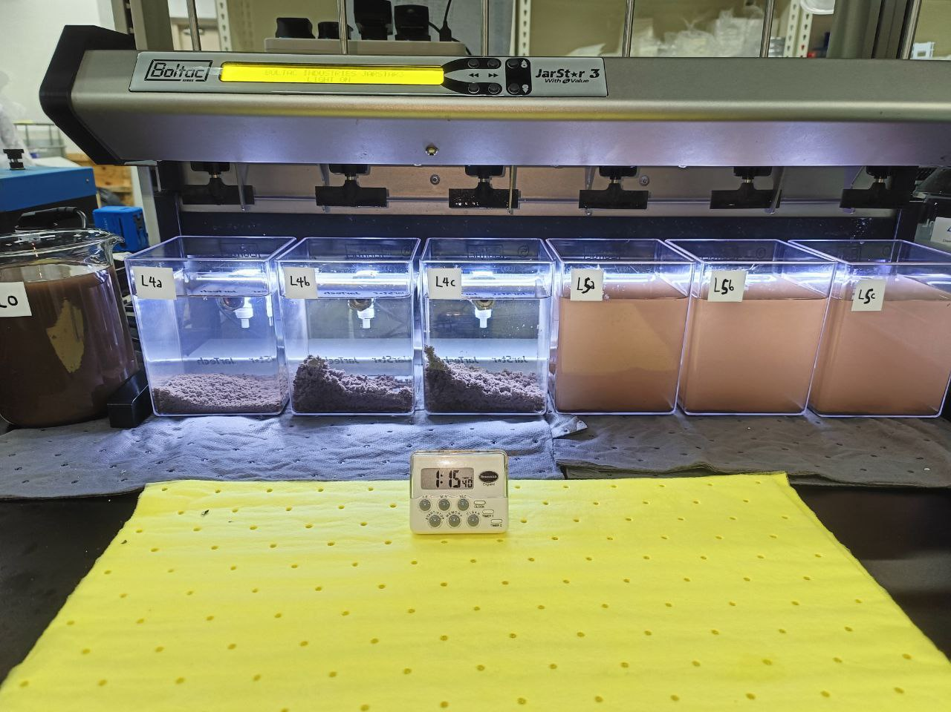
I) 17 Jan 2023 – pH-corrected feed; MgO & MgCl2 solution dosing
Polymer addition
Initial feed pH correction
Volume of 10% NaOH added to 6,500mL:
~8.3 mL
pH:
8.7 → 11.3
Settling 15 mins
Settling 30 mins

Slide 21
I) 17 Jan 2023 – Sequential PolyDADMAC & MgCl2 dosing
 | (1a) Control | (1b) Control – pH11 | (2) MgCl2 470mg/L | (3) MgCl2 590mg/L | (4) MgCl2 705mg/L | (5) MgO 200mg/L | (6) MgO 250mg/L | (7) MgO 300mg/L
 | Feed | Feed | Supernatant | Supernatant | Supernatant | Supernatant | Supernatant | Supernatant
Mg:SiO2 | - | - | 0.2 | 0.25 | 0.3 | 0.2 | 0.25 | 0.3
pH | 8.7 | 10.9 | 10.7 | 10.7 | 10.7 | 10.9 | 11.0 | 11.0
Turbidity, NTU | 3,270 | 2,670 | ongoing | ongoing | ongoing | ongoing | ongoing | ongoing
TSS, mg/L | 1,710 | 1,530 | ongoing | ongoing | ongoing | ongoing | ongoing | ongoing
Total Silica, mg/L | 539 | 616 | 59.3 | 31.7 | 20 | 270 | 240 | 265
Dissolved Silica, mg/L | 436 | 453 | 58.8 | 32.3 | 19 | 227 | 225 | 261
Conductivity, μS/cm | 63.9 | 524 | 1,225 | 1,365 | 1,623 | 513 | 503 | 518
^TDS, mg/L | 398 | 524 | 660 | 748 | 845 | 526 | 530 | 526
Mg, mg/L | ongoing | ongoing | 5 | 6.63 | 7.93 | 7.72 | 8.83 | 8.8
Cl, mg/L | 14.4* | 14.2* | 293 | 373 | 421 | 14.4 | 14.5 | 14.5
^TDS using gravimetric method, instead of Ultrameter
*filtered through 0.45μm to remove suspended solids

